Slide 1
TorchQuantum Case Study for Robust Quantum Circuits
Hanrui Wang¹, Zhiding Liang², Jiaqi Gu³, Zirui Li⁴, Yongshan Ding⁵, Weiwen Jiang⁶, Yiyu Shi², David Z. Pan³, Frederic T. Chong⁷, Song Han¹
¹MIT, ²Notre Dame, ³UT Austin, ⁴Rutgers, ⁵Yale, ⁶GMU, UChicago⁷

Slide 2

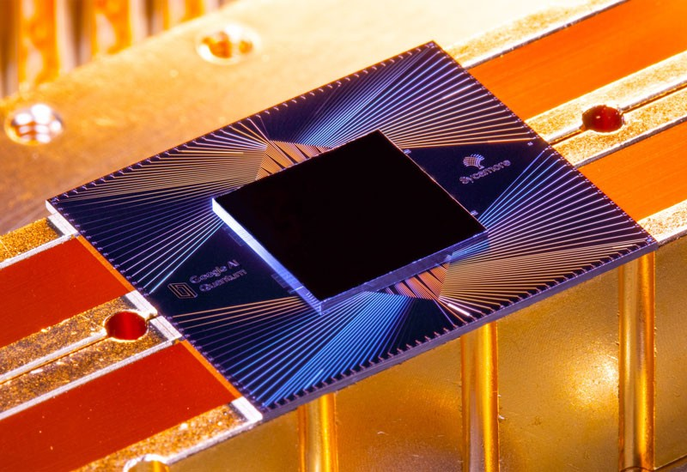
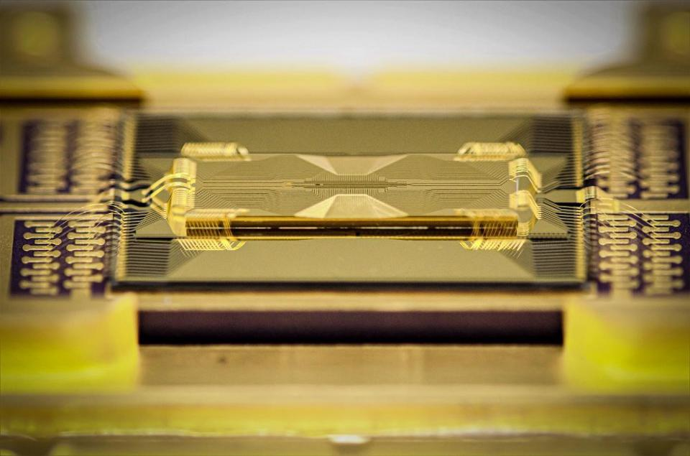
Quantum Computing
Fast progress of quantum devices
Different technologies
Superconducting, trapped ion, neutral atom, photonics, etc.
IBM 127 Qubit
Google 53 Qubits
IonQ 32+ Qubits
Notes:
The current pace of hardware development in quantum computing is very fast
We have different technologies
The number of qubits

Slide 3
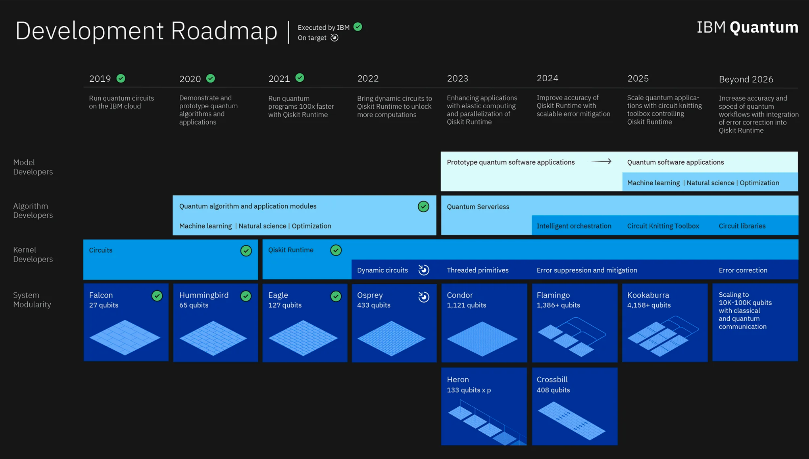
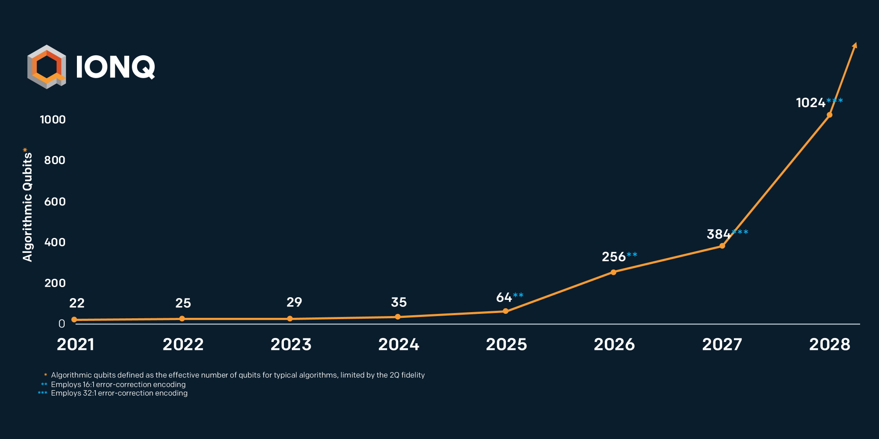
Quantum Computing
The number of qubits increases exponentially over time
The computing power increases exponentially with the number of qubits
=> “doubly exponential” rate
IBM Roadmap
IonQ Roadmap
Notes:
The number of qubits increases exponentially over time
The computing power increases exponentially over number of qubits
So it’s a double exponential increase

Slide 4
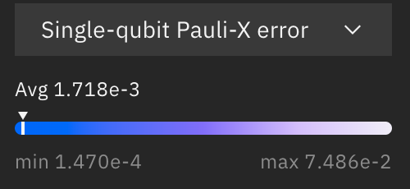
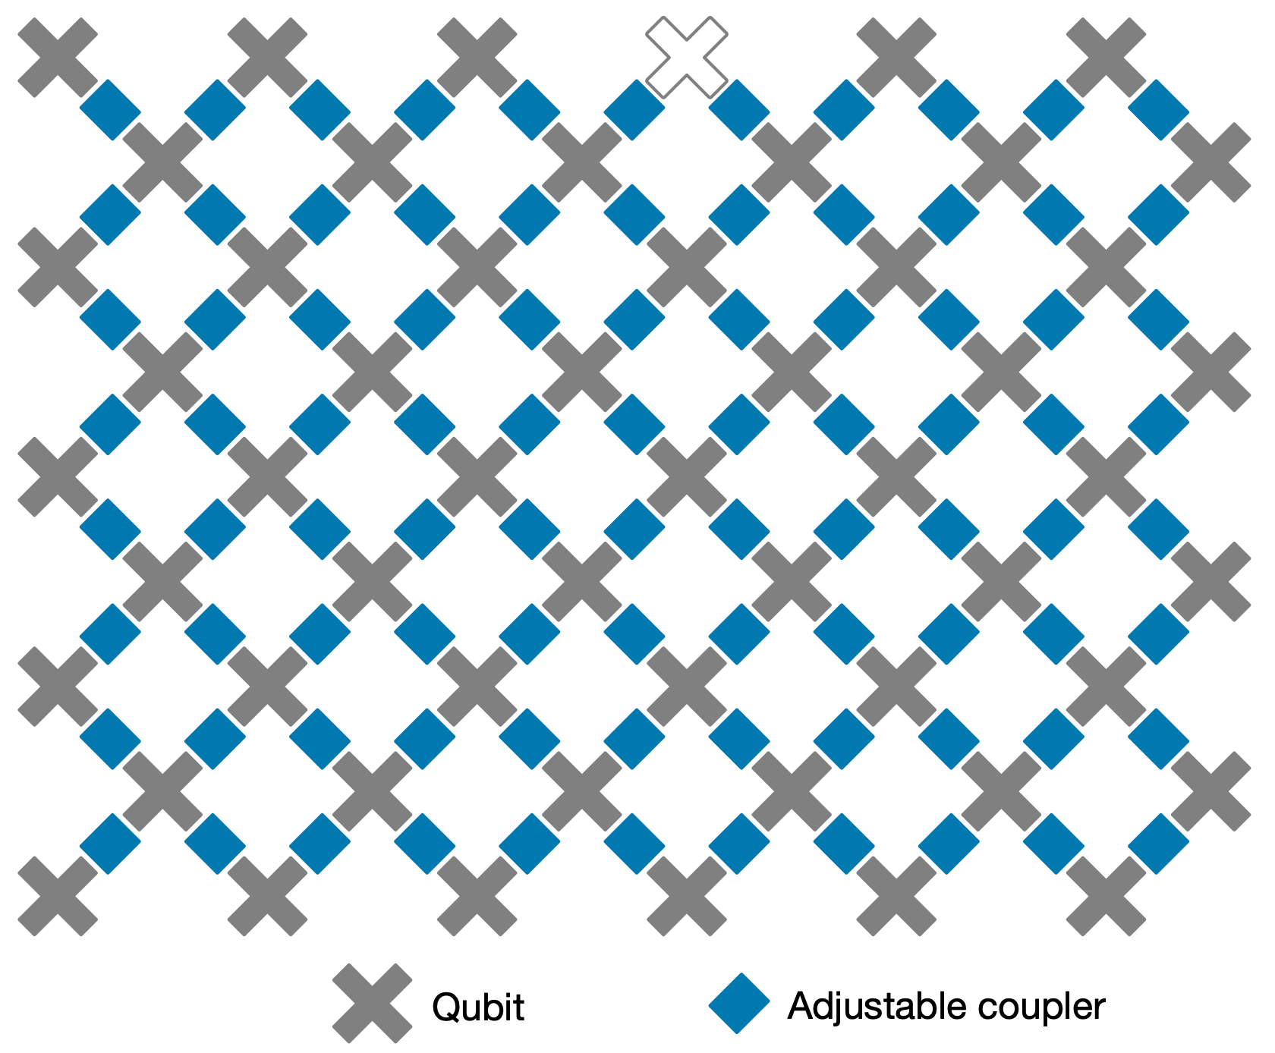
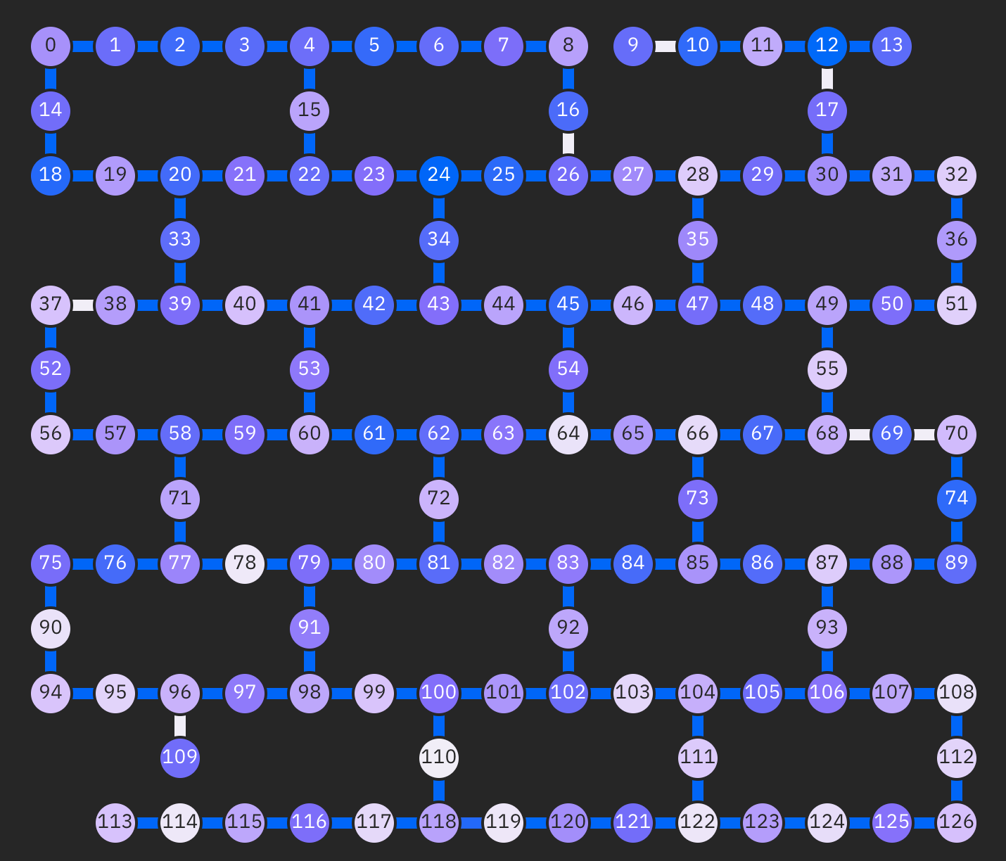
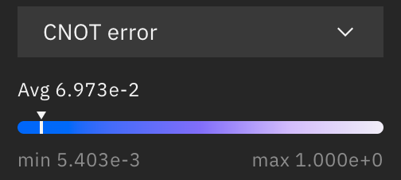
Quantum Computing in NISQ Era
Noisy Intermediate-Scale Quantum (NISQ)
Noisy: qubits are sensitive to environment; quantum gates are unreliable
Limited number of qubits: tens to hundreds of qubits
Limited connectivity: no all-to-all connections
Google Sycamore 53Q
IBM Washington 127Q
IBMQ Gate Error Rate
https://www.nature.com/articles/s41586-019-1666-5
https://quantum-computing.ibm.com/
https://quantum-computing.ibm.com/
Notes:
Despite of the exciting progress, we will still be in the NISQ era for several year in which we have noisy qubit and limited qubit numbers

Slide 5
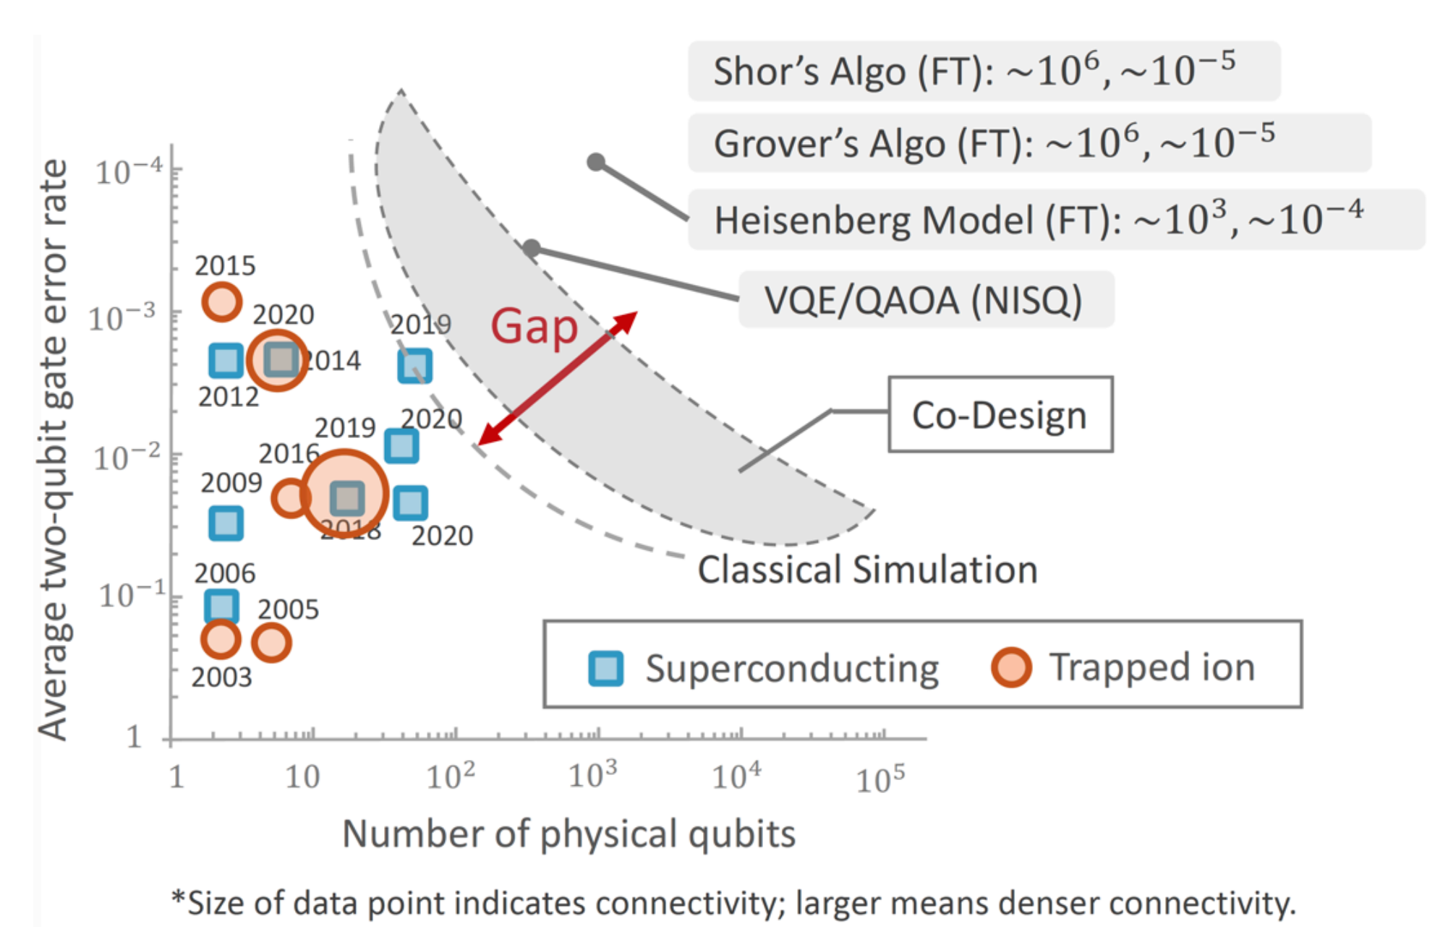
A Large Gap between Powerful Quantum Algorithms and Current Devices
Close the gap with machine learning and hardware-aware algorithm design
Fred Chong, https://indico.fnal.gov/event/47147/attachments/138920/174186/Chong-JTFI-2021.pdf18.pdf
Notes:
Our lab focus on the intersection of machine learning and quantum computing
We want to close the gap with ML and codesign of quantum algorithm and hardware
For example, we can use ML to optimize the circuit architecture, use ML to predict the noise drift and then mitigate, codesign the qubit mapping and circuit architecture aware of real quantum noise etc.

Slide 6
Good Infrastructure is Critical
To enable ML-assisted hardware-aware quantum algorithm design
Need a simulation framework on classical computer
Fast speed
Convenience: PyTorch native
Portable between different frameworks with common Quantum IR
Scalable
Analyze circuit behavior
Study noise impact
Develop ML model for quantum optimization

Slide 7
TorchQuantum Library
A fast library for classical simulation of quantum circuit in PyTorch
Automatic gradient computation for training parameterized quantum circuit
GPU-accelerated tensor processing with batch mode support
Density matrix and state vector simulators
Dynamic computation graph for easy debugging
Easy construction of hybrid classical and quantum neural networks
Gate level and pulse level simulation support
Converters to other frameworks such as IBM Qiskit
And so on…

Slide 8

TorchQuantum Tutorial Outline
Section 1
Section 2
Section 3
TorchQuantum Basic Usage
Use TorchQuantum on Pulse Level Optimization
Use TorchQuantum on Gate Level Optimization
1.1 Quantum Basics
3.1 QuantumNAS: Ansatz Search and Gate Pruning
2.1 Quantum Optimal Control
1.2 TQ Operations
3.2 QuantumNAT: Noise Injection and Quantization
1.3 TQ Use Examples
2.2 Variational Pulse Learning
3.3 QOC: On-Chip Training
3.4 Transformer for Quantum Circuit Reliability Prediction
1.4 QNN Compression

Slide 9
TorchQuantum Tutorial Outline
Section 1
Section 2
Section 3
TorchQuantum Basic Usage
Use TorchQuantum on Pulse Level Optimization
Use TorchQuantum on Gate Level Optimization
1.1 Quantum Basics
3.1 QuantumNAS: Ansatz Search and Gate Pruning
2.1 Quantum Optimal Control
1.2 TQ Operations
3.2 QuantumNAT: Noise Injection and Quantization
1.3 TQ Use Examples
2.2 Variational Pulse Learning
3.3 QOC: On-Chip Training
3.4 Transformer for Quantum Circuit Reliability Prediction
1.4 QNN Compression

Slide 10
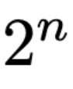
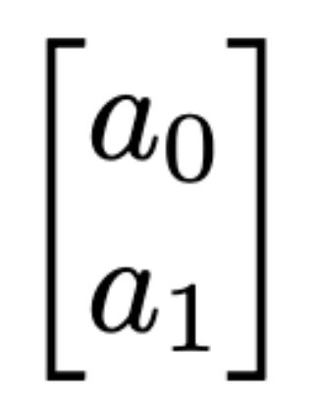
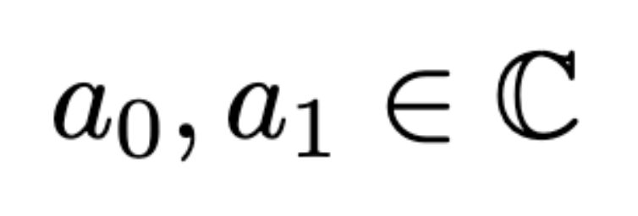
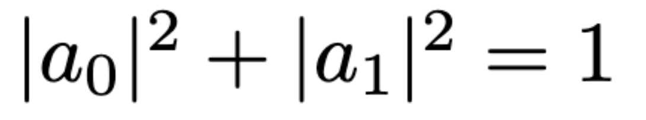
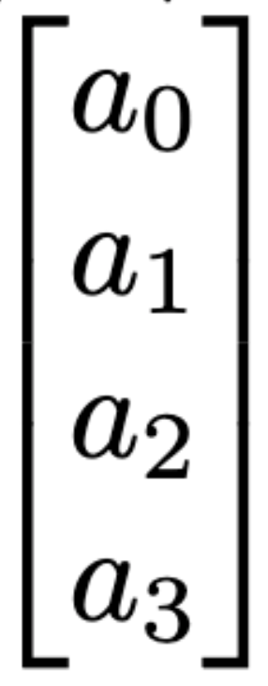
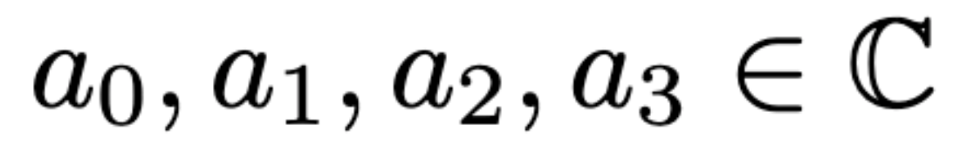
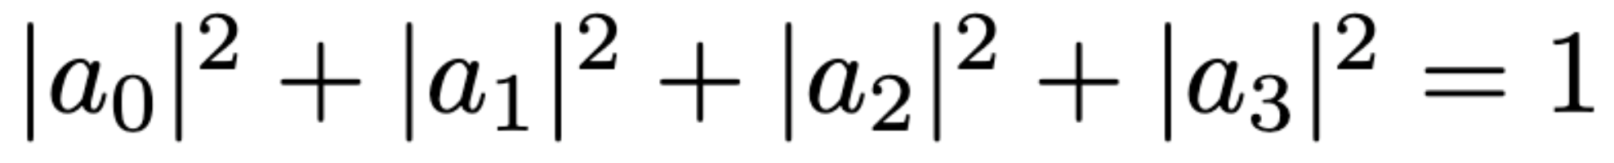
Quantum Bit
Quantum Bit (Qubit)
Statevector: contains complex numbers for n qubit system
The square sum of magnitude of numbers are 1
1 qubit:
2 qubits:

Slide 11
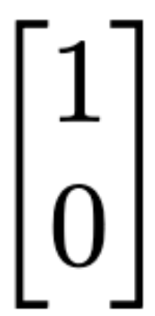

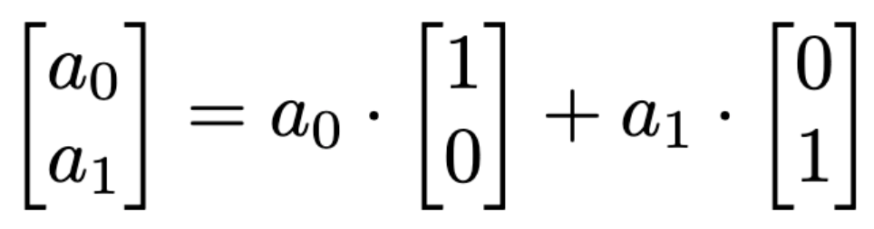
Quantum Bit
Classical bits represented in statevector
Classical 0:
Classical 1:
An arbitrary quantum states:

Slide 12
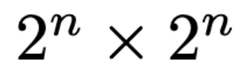
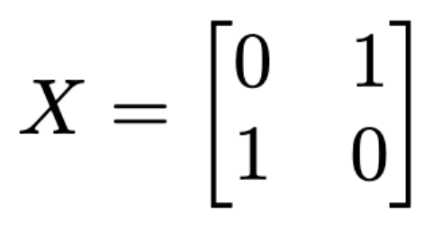
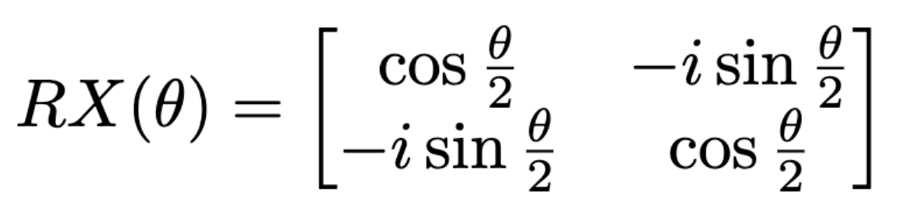
Quantum Gates
Qubit gates: operations on one qubit or multiple qubits
The qubit gates can be represented with matrix format with dimension
All gate matrices are unitary matrices: the conjugate transpose is the same as its inverse
Single qubit gates:
Not (X) gate:
Parameterized gate: Rotation X (RX) with parameter theta

Slide 13
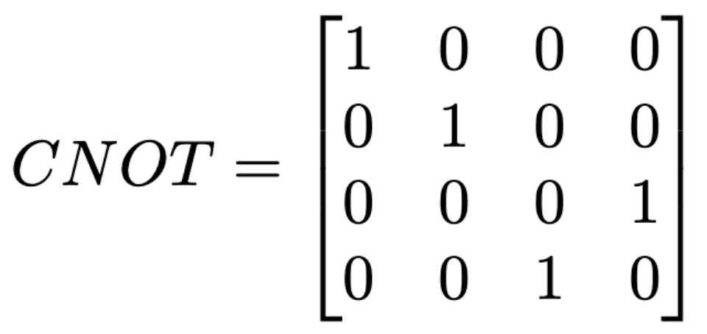
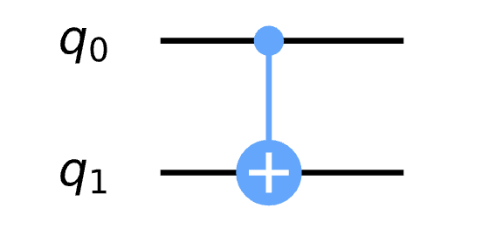
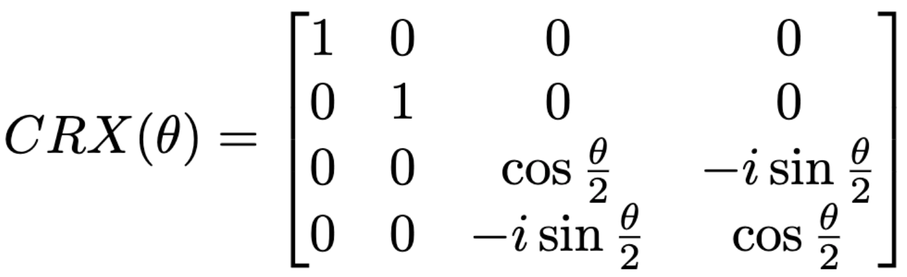
Quantum Gates
2-qubit gates:
Controlled Not (CNOT) gate:
Controlled Rotation X (CRX) gate
Output
Input
00
01
10
11
00
Control
01
Target
10
11

Slide 14
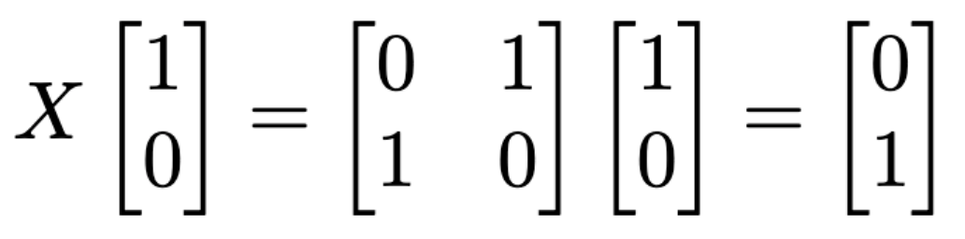
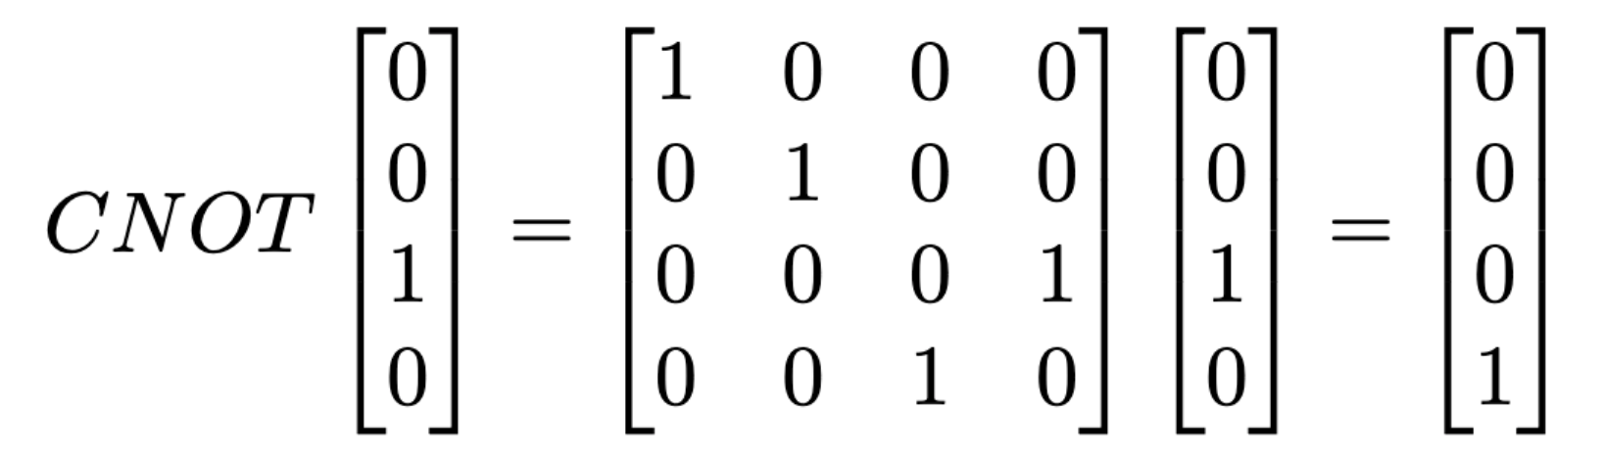
Quantum Gates
Applying a gate to qubits is performing matrix-vector multiplication between the gate matrix and statevector
Apply an X gate to classical state 0, we get 1
Apply an CNOT gate to state 10, we get 11

Slide 15
TorchQuantum Tutorial Outline
Section 1
Section 2
Section 3
TorchQuantum Basic Usage
Use TorchQuantum on Pulse Level Optimization
Use TorchQuantum on Gate Level Optimization
1.1 Quantum Basics
2.1 QuantumNAS: Ansatz Search and Gate Pruning
3.1 Quantum Optimal Control
1.2 TQ Operations
2.2 QuantumNAT: Noise Injection and Quantization
1.3 TQ Use Examples
3.2 Variational Pulse Learning
2.3 QOC: On-Chip Training
2.4 Transformer for Quantum Circuit Reliability Prediction
1.4 QNN Compression

Slide 16
TQ for Statevector simulation
Performing matrix-vector multiplication between the gate matrix and statevector
The tq.QuantumDevice stores the statevectors
q_dev = tq.QuantumDevice(n_wires=5)
Two ways of applying quantum gates: method 1:
import torchquantum.functional as tqf
tqf.h(q_dev, wires=1)

Slide 17
TQ for Statevector simulation
Performing matrix-vector multiplication between the gate matrix and statevector
The tq.QuantumDevice stores the statevectors
q_dev = tq.QuantumDevice(n_wires=5)
Two ways of applying quantum gates: method 2:
h_gate = tq.H()
h_gate(q_dev, wires=3)

Slide 18
TQ for Statevector simulation
Performing matrix-vector multiplication between the gate matrix and statevector
The tq.QuantumState class can also store the statevectors
q_state = tq.QuantumState(n_wires=5)
Three ways of applying quantum gates
import torchquantum.functional as tqf
tqf.h(q_state, wires=1)
h_gate = tq.H()
h_gate(q_state)
q_state.h()
q_state.rx(wires=1, params=0.2 * np.pi)

Slide 19
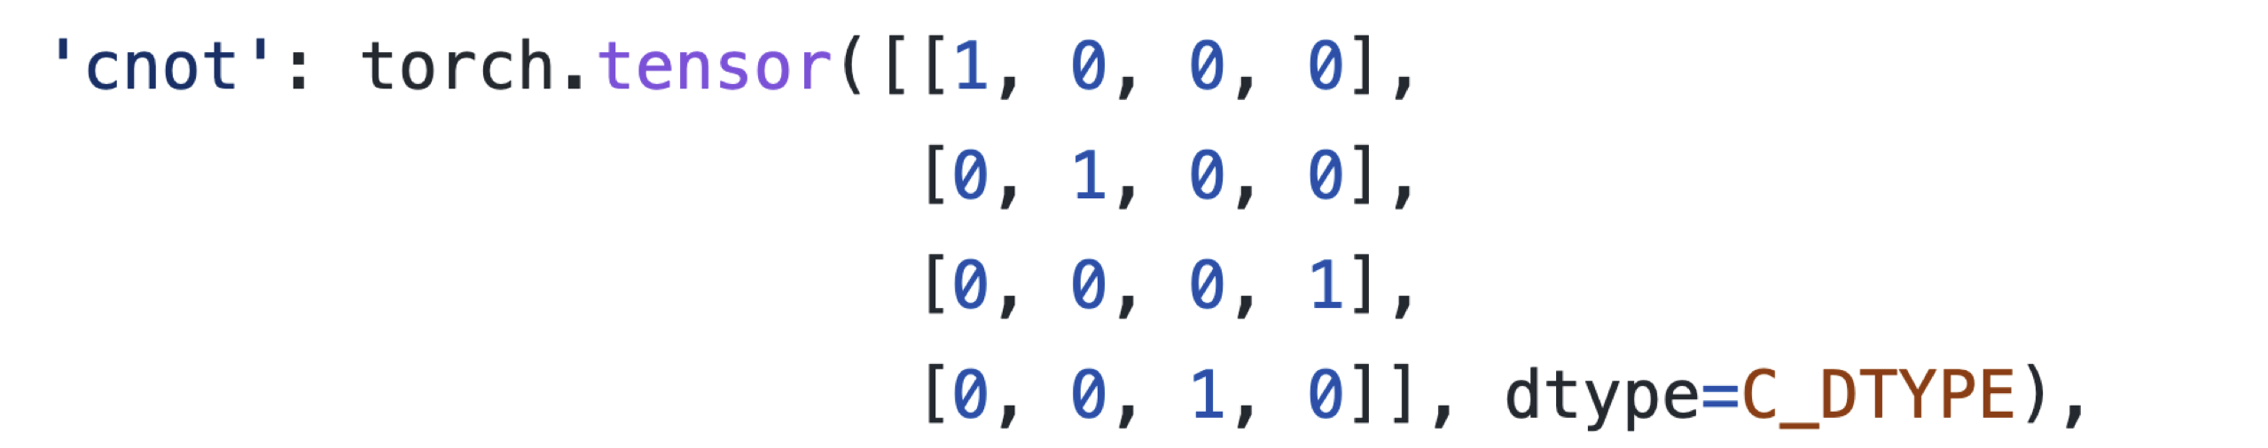
TQ for Statevector simulation
Performing matrix-vector multiplication between the gate matrix and statevector
The implementation of statevector and quantum gates are using the native data structure in PyTorch

Slide 20
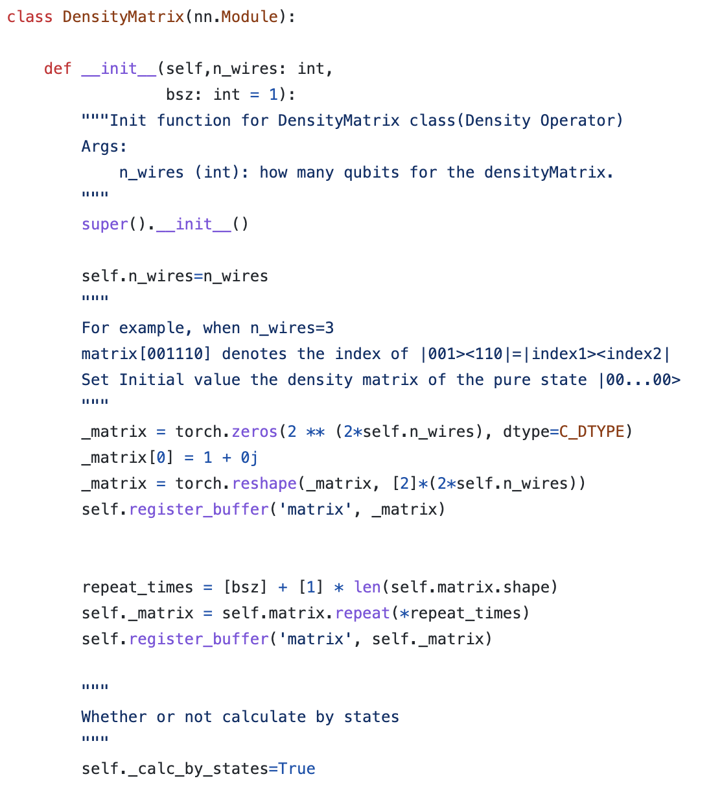
TQ for Density Matrix simulation
Performing matrix-vector multiplication between the gate matrix and statevector
The tq.QuantumState class can also store the statevectors
q_mat = tq.DesityMatrix(n_wires=5)
Applying quantum gates
q mat.h()
q_mat.rx(wires=1, params=0.2 * np.pi)

Slide 21
Dynamic computation graph
Performing matrix-vector multiplication between the gate matrix and statevector
The tq.QuantumState class can also store the statevectors
q_state = tq.QuantumState(n_wires=5)
q_state.h(wires=1)
print(q_state)
q_state.sx(wires=3)
print(q_state)

Slide 22
Batch Mode Tensorized Processing
Performing matrix-vector multiplication between the gate matrix and statevector
The tq.QuantumState class can also store the statevectors
q_state = tq.QuantumState(n_wires=5, bsz=64)

Slide 23
GPU Support
Performing matrix-vector multiplication between the gate matrix and statevector
The tq.QuantumState class can also store the statevectors
q_state = tq.QuantumState(n_wires=5, bsz=64)
q_state.to(torch.device(‘cuda’))
Leverage the fast GPU support

Slide 24
Automatic Gradient Computation
Performing matrix-vector multiplication between the gate matrix and statevector
The tq.QuantumState class can also store the statevectors
q_state = tq.QuantumState(n_wires=2)
target_quantum_state = torch.tensor([0, 0, 0, 1])
loss = 1 - (q_state.get_states_1d()[0] @ target_quantum_state).abs()
loss.backward()

Slide 25
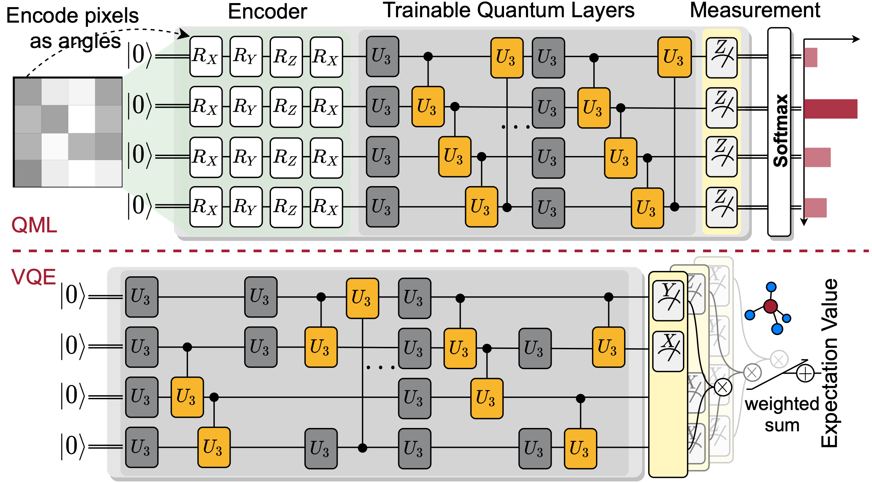
Encoding Classical Data to Quantum various encoder support
tq.AmplitudeEncoder() encodes the classical values to the amplitude of quantum statevector
tq.PhaseEncoder() encodes the classical values using the rotation gates

Slide 26
Construct a Circuit Class
Construct a class for circuit model
tq.QuantumModule class
In the __init__ function, create all the gates that will be used
In the forward function, specify how the gates will be used in the circuit
Class q_model(tq.QuantumModule) def __init__(): self.n_wires = 2 self.rx_0 = tq.RX(has_params=True, trainable=True) self.ry_0 = tq.RY(has_params=True, trainable=True) def forward(q_dev): self.rx_0(q_dev) self.ry_0(q_dev)

Slide 27
Conversion tq model to other frameworks
Convert the tq.QuantumModule to other frameworks such as Qiskit
from torchquantum.plugins.qiskit_plugin import tq2qiskit
circ = tq2qiskit(q_dev, q_model)
circ.draw('mpl')

Slide 28
Easy Deployment on Real Quantum Machines
Convert the tq.QuantumModule to other frameworks such as Qiskit
from torchquantum.plugins.qiskit_plugin import tq2qiskit
from torchquantum.plugins.qiskit_processor import QiskitProcessor
processor = QiskitProcessor(use_real_qc=False, max_jobs=1)
circ = tq2qiskit(q_dev, model)
circ.measure_all()
res = processor.process_ready_circs(q_dev, [circ])

Slide 29
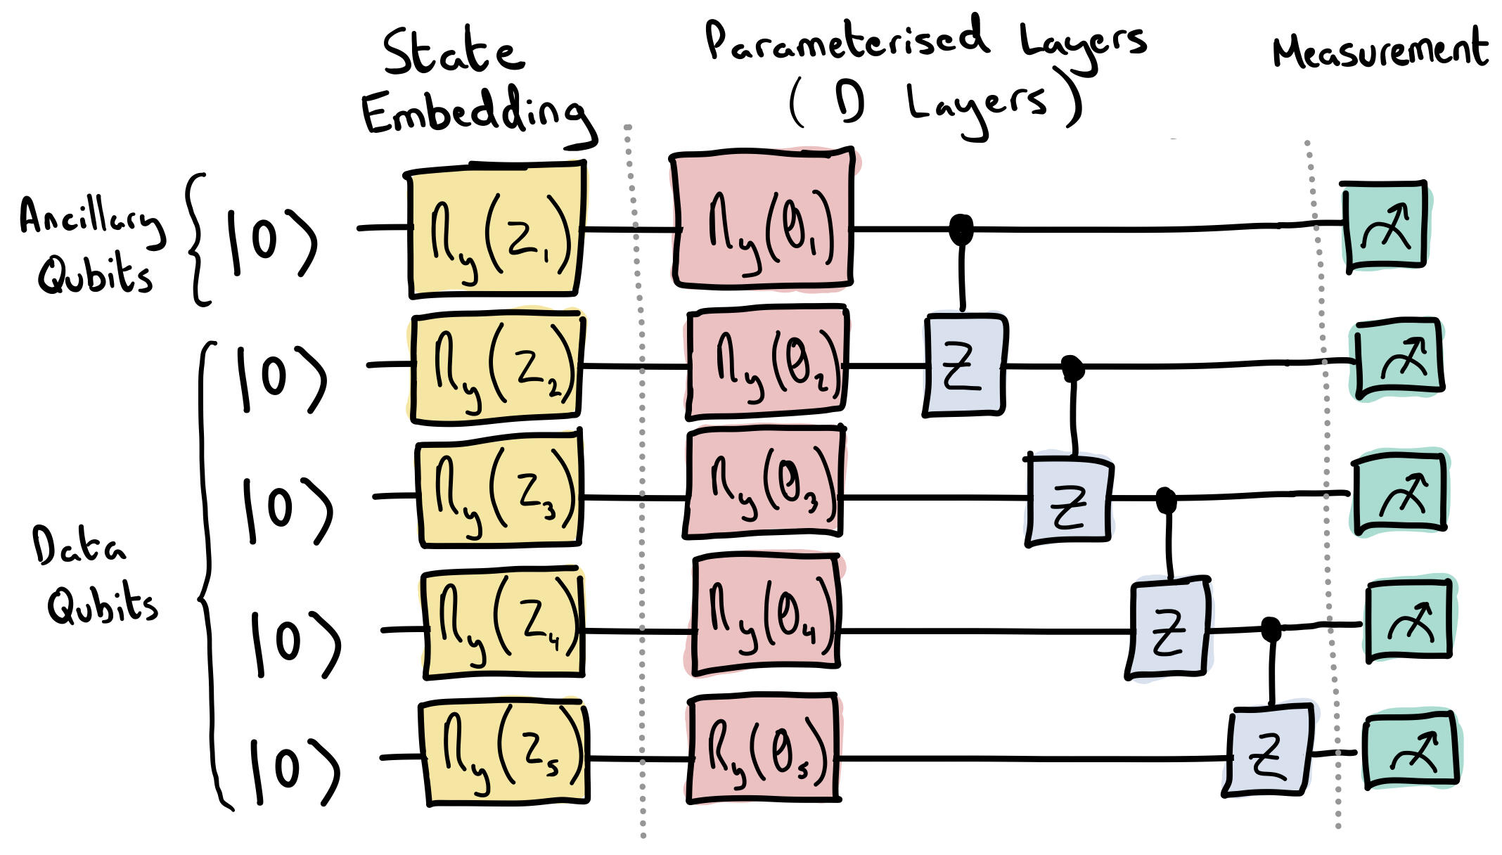
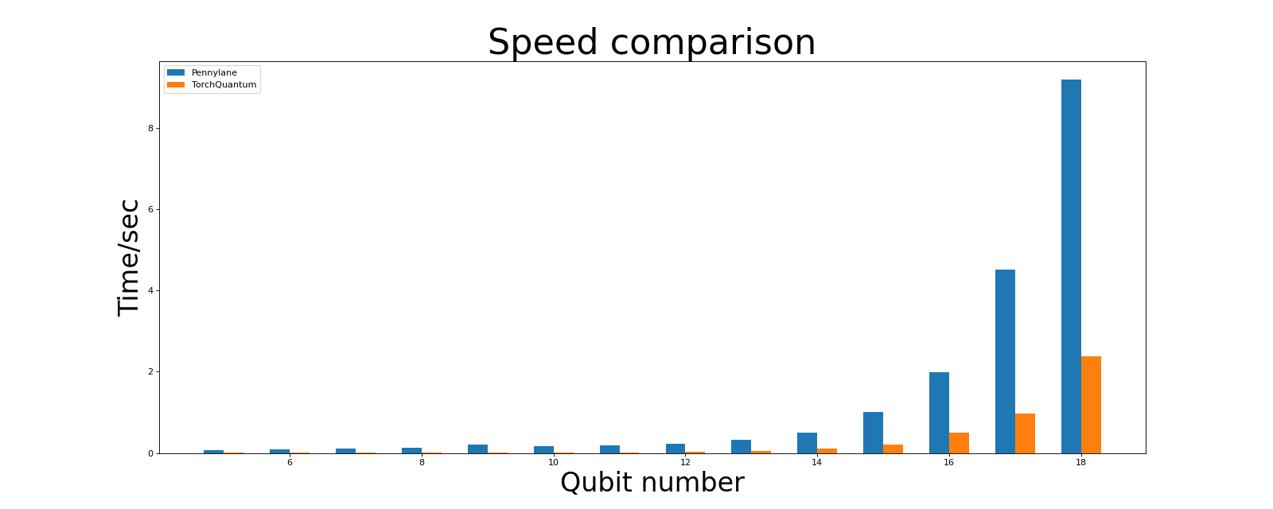
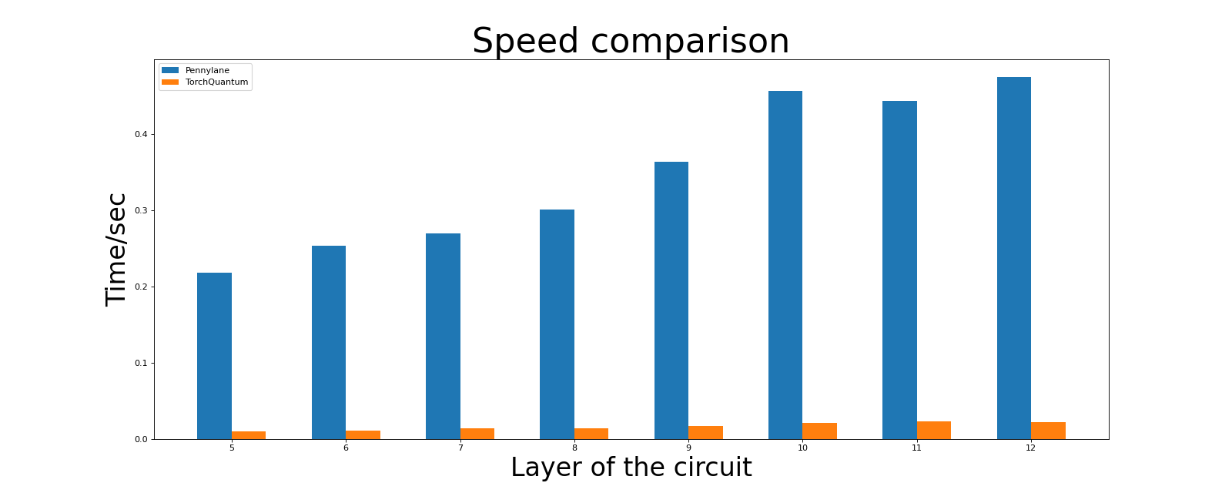
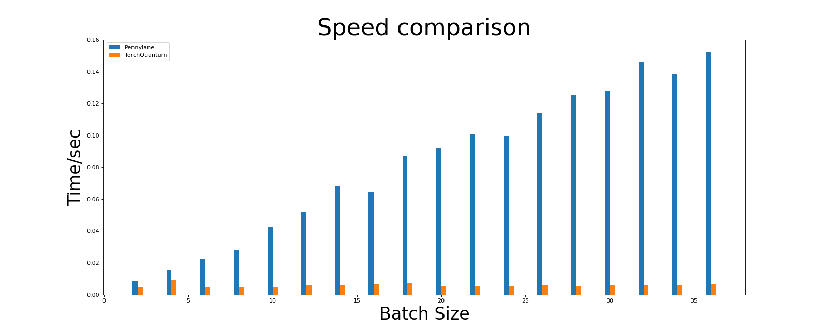
Compare the Speed of TQ and Pennylane
https://pennylane.ai/qml/_images/qcircuit.jpeg

Slide 30



Hands-On Section 1.2 TorchQuantum Operations

Slide 31
TorchQuantum Tutorial Outline
Section 1
Section 2
Section 3
TorchQuantum Basic Usage
Use TorchQuantum on Pulse Level Optimization
Use TorchQuantum on Gate Level Optimization
1.1 Quantum Basics
2.1 QuantumNAS: Ansatz Search and Gate Pruning
3.1 Quantum Optimal Control
1.2 TQ Operations
2.2 QuantumNAT: Noise Injection and Quantization
1.3 TQ Use Examples
3.2 Variational Pulse Learning
2.3 QOC: On-Chip Training
2.4 Transformer for Quantum Circuit Reliability Prediction
1.4 QNN Compression

Slide 32
State Preparation with Parameterized Circuit
Use parameterized circuit to prepare initial quantum states
Circuit Ansatz

Slide 33
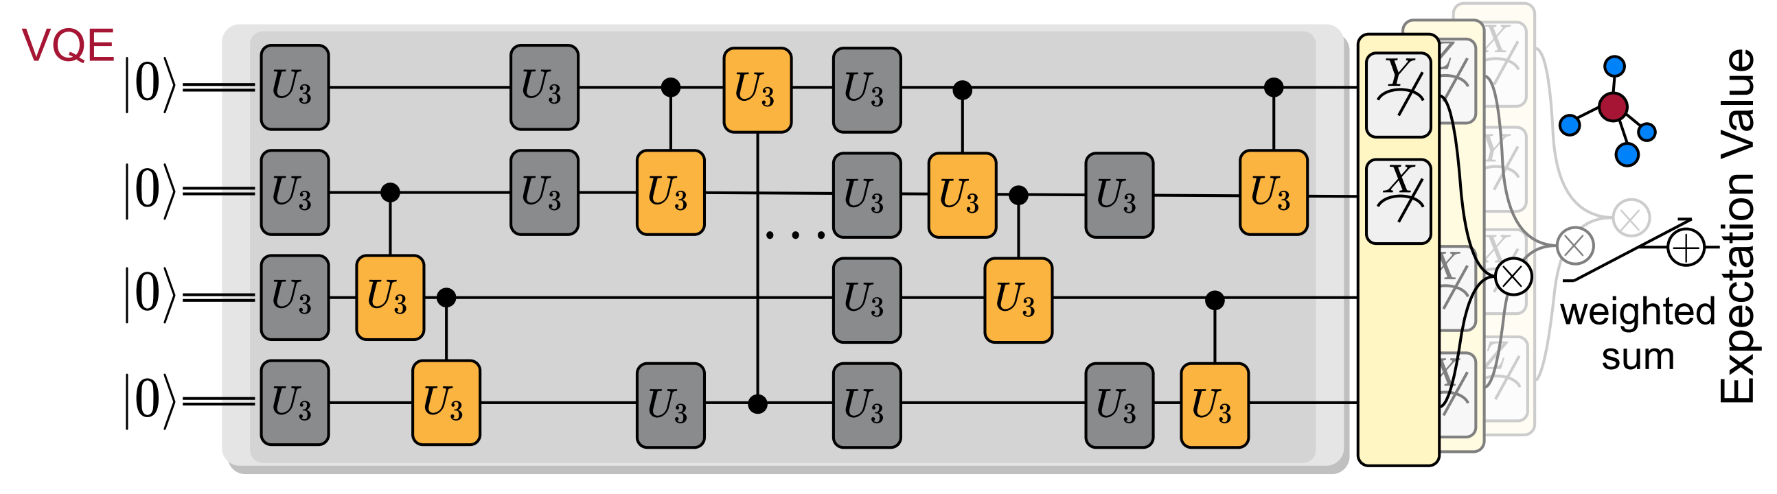
Variational Quantum Eigensolver
VQE: Finds the ground state energy of molecule Hamiltonian

Slide 34
Quantum Neural Networks for MNIST Classification
Encode the classical values using phase encoding
Then trainable quantum layers
Finally measurement layers

Slide 35
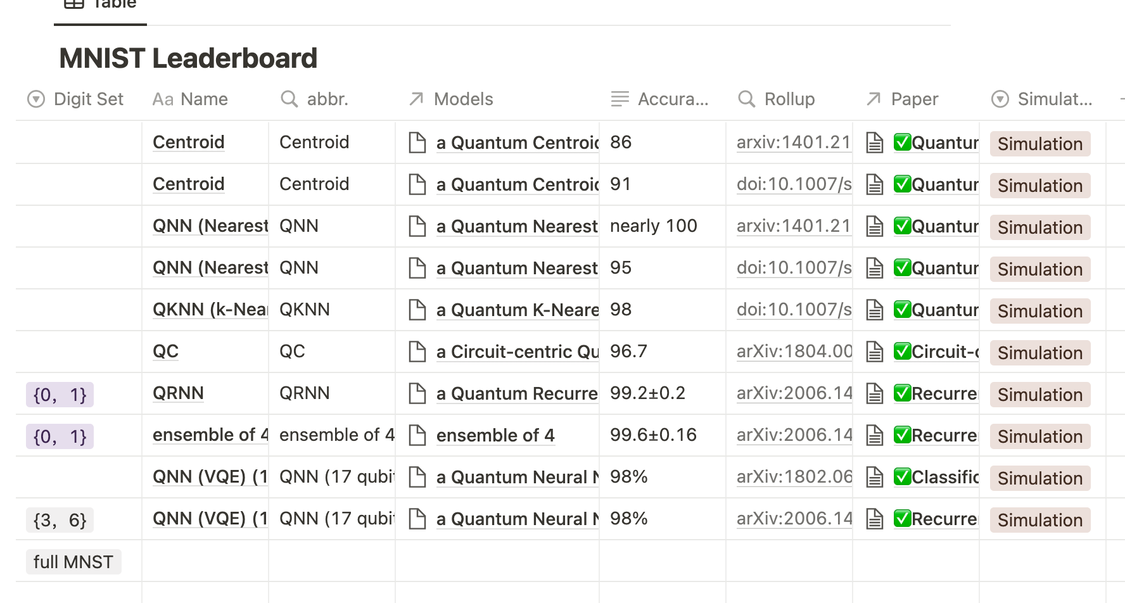
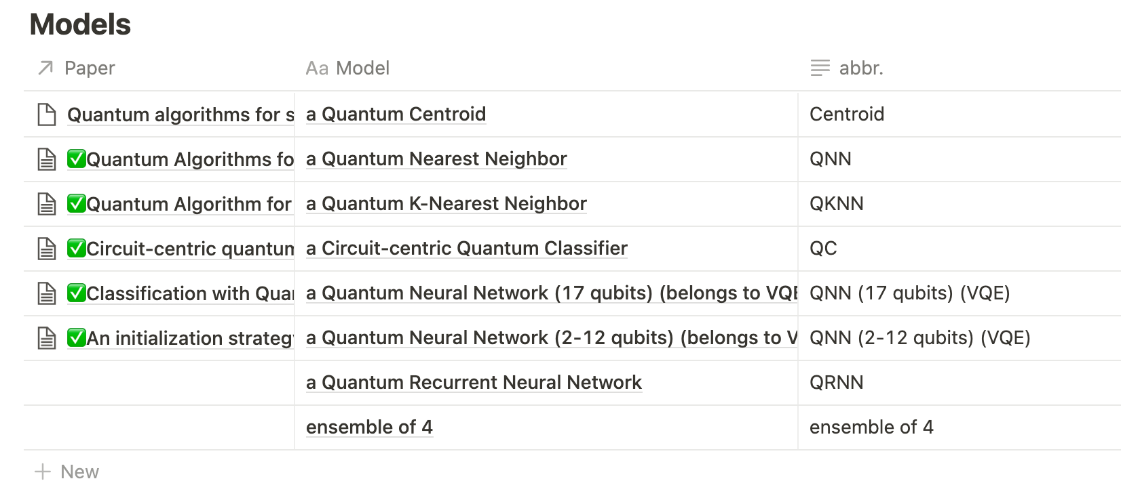
TorchQuantum Hub
QML leaderboard: dataset, accuracy, implementation etc
Continuously adding new results

Slide 36
Hands-On Section 1.3 TQ Use Examples

Slide 37
TorchQuantum Tutorial Outline
Section 1
Section 2
Section 3
TorchQuantum Basic Usage
Use TorchQuantum on Pulse Level Optimization
Use TorchQuantum on Gate Level Optimization
1.1 Quantum Basics
2.1 QuantumNAS: Ansatz Search and Gate Pruning
3.1 Quantum Optimal Control
1.2 TQ Operations
2.2 QuantumNAT: Noise Injection and Quantization
1.3 TQ Use Examples
3.2 Variational Pulse Learning
2.3 QOC: On-Chip Training
2.4 Transformer for Quantum Circuit Reliability Prediction
1.4 QNN Compression

Slide 38
Quantum Neural Network Compression
Zhirui Hu¹, Peiyan Dong², Zhepeng Wang¹, Youzuo Lin³, Yanzhi Wang², Weiwen Jiang¹
¹ George Mason University
² Northeastern University
³ Los Alamos National Laboratory

Slide 39
TorchQuantum Tutorial Outline
Section 1
Section 2
Section 3
TorchQuantum Basic Usage
Use TorchQuantum on Pulse Level Optimization
Use TorchQuantum on Gate Level Optimization
1.1 Quantum Basics
2.1 QuantumNAS: Ansatz Search and Gate Pruning
2.1 Quantum Optimal Control
1.2 TQ Operations
2.2 QuantumNAT: Noise Injection and Quantization
1.3 TQ Use Examples
2.2 Variational Pulse Learning
2.3 QOC: On-Chip Training
2.4 Transformer for Quantum Circuit Reliability Prediction
1.4 QNN Compression

Slide 40
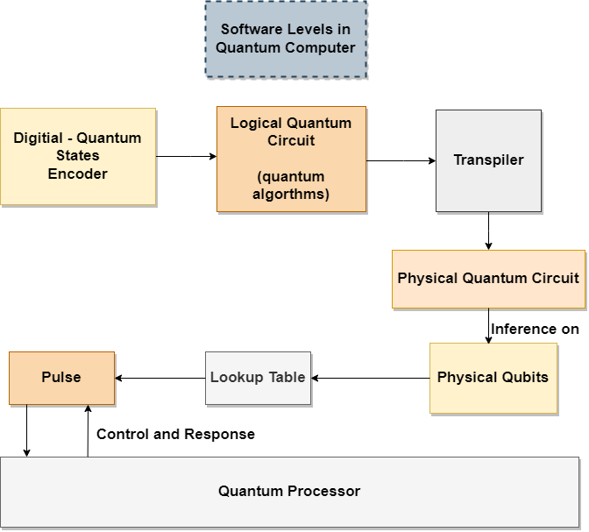
Brief Overview of Workflow
When we want to execute a quantum program on a quantum computer, we need to compile it first:
Notes:
The program is first compiled into .qasm files.
Since the qubits in current quantum hardware is not fully-connected. Some gates in .qasm files could not be performed on quantum computer. The conflicts need to be solved through qubit mapping.
The mapped .qasm files are then translated into control-pulses and executed on quantum computer.
Currently control pulses are generated through gate-based compilation.
We manage to mitigate cross-talk effects with our mapping algorithm.
We divide programs into groups of gates. Instead of generating pulses for gates, we generate pulses for groups.

Slide 41
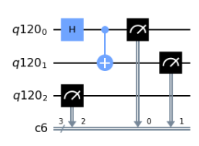
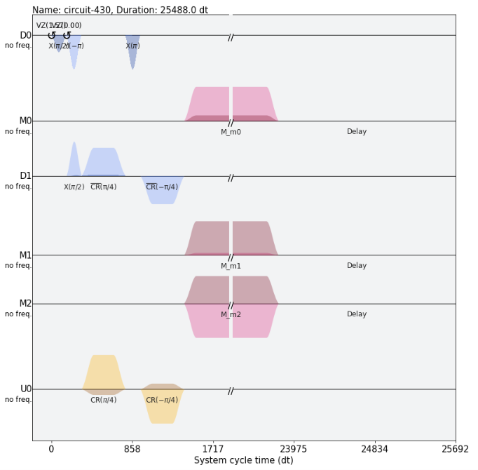
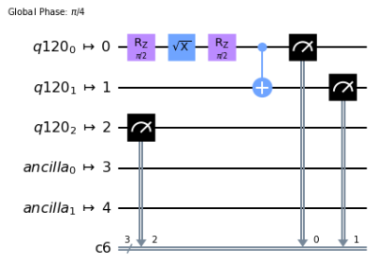
Pulse-Based and Gate-Based
Gate- and Pulse-level are two different abstraction layers.

Slide 42
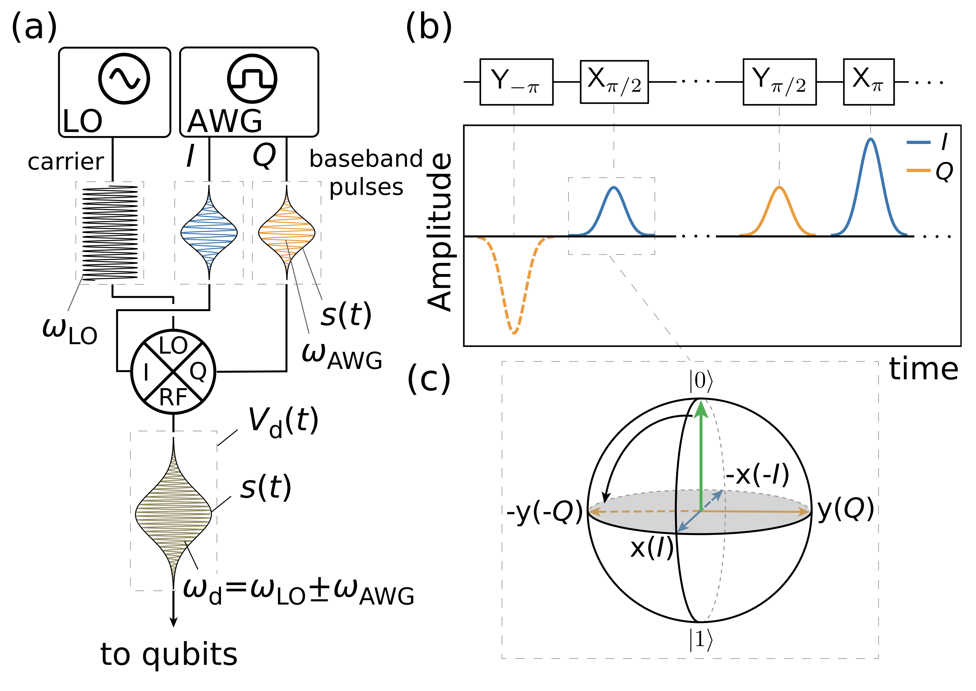
Pulse-Based and Gate-Based
The microwave is used to control the quantum bits.
Krantz, Philip, et al. "A quantum engineer's guide to superconducting qubits." Applied Physics Reviews 6.2 (2019): 021318.

Slide 43
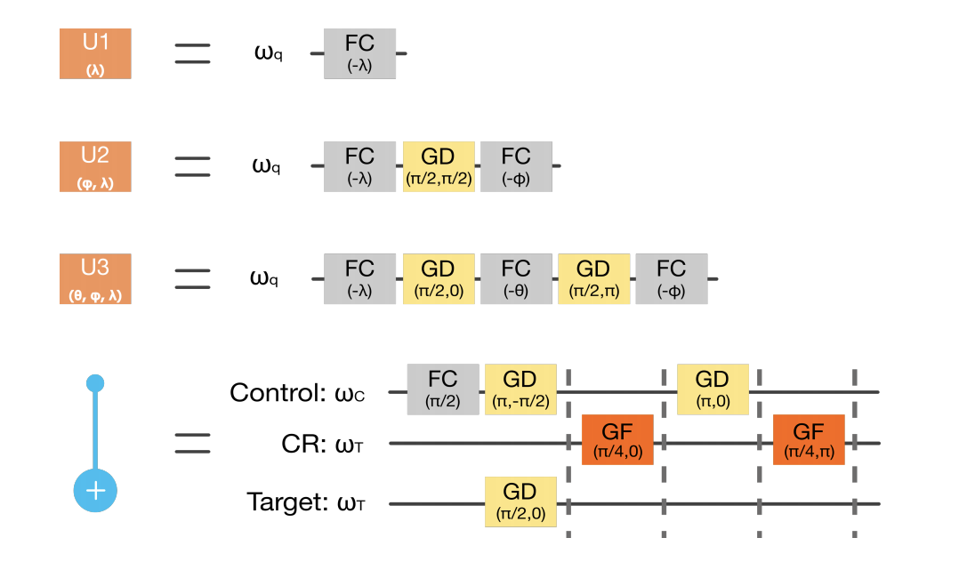
Gate-based Compilation
Each gate corresponds to a pulse. One-by-one concatenation of all pulses realize the function of many gates.
Notes:
Each gate corresponds to a pulse. One-by-one concatenation of all pulses realize the function of many gates.
The gate-based compilation requires little computing resource.
The outcome pulse latency is high.

Slide 44
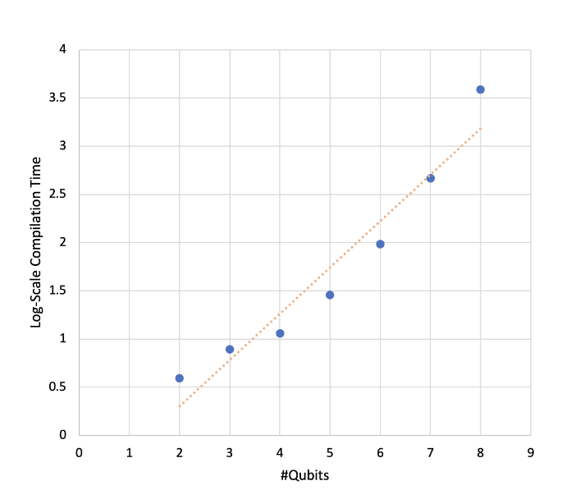
Quantum Optimal Control(QOC)
QOC is commonly used to generate pulses (from target unitary matrices to pulses)
QOC is computationally expensive
Notes:
Gradient methods are resource consuming
The latency of pulse is reduced compared to gate-based method.
Takes hours/days to generate pulses for large quantum programs
Compilation times exponential to the number of Qubits

Slide 45
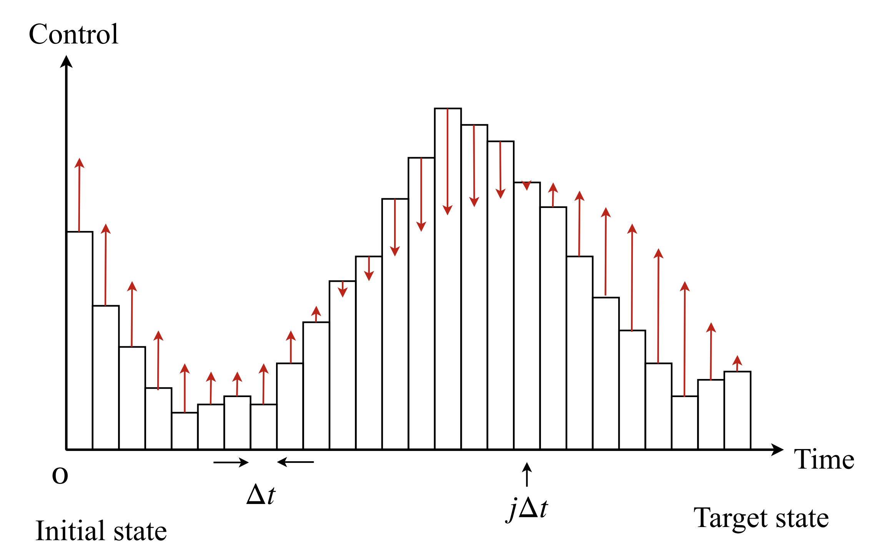
Quantum Optimal Control (QOC)
As shown in the figure, the control pulse is divided into multiple time slots. The amplitude of each time slot will be adjusted through optimization.
Shi, Yunong, et al. "Optimized compilation of aggregated instructions for realistic quantum computers." 2019.
Notes:
QOC is basically an optimization problem. By updating control pulses, the final unitary matrix of these control pulses will approximate the target unitary matrix.
As shown in the figure, the control pulse is divided into multiple time slices. The amplitude of each slice will be adjusted through optimization.
Therefore, the initialization of control pulses will effect the #iterations. If the initial pulse and the final pulse is similar. We expect to see faster convergence.

Slide 46
TorchQuantum Tutorial Outline
Section 1
Section 2
Section 3
TorchQuantum Basic Usage
Use TorchQuantum on Pulse Level Optimization
Use TorchQuantum on Gate Level Optimization
1.1 Quantum Basics
2.1 QuantumNAS: Ansatz Search and Gate Pruning
2.1 Quantum Optimal Control
1.2 TQ Operations
2.2 QuantumNAT: Noise Injection and Quantization
1.3 TQ Use Examples
2.2 Variational Pulse Learning
2.3 QOC: On-Chip Training
2.4 Transformer for Quantum Circuit Reliability Prediction
1.4 QNN Compression

Slide 47
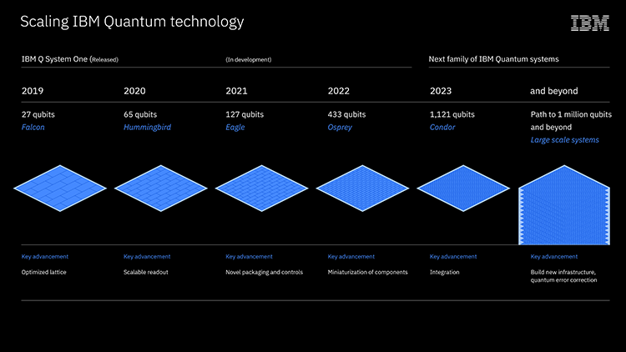
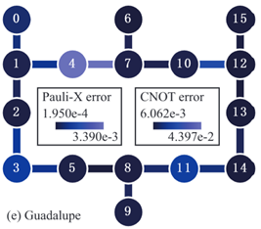
Variational Quantum Pulse Learning (VQP)
Coherence time is limited in NISQ machines, which means we cannot perform a huge quantum circuit with enough depth and width in NISQ machines.
Noise and compilation overhead seriously affect the performance of a quantum program.
Error rate on a bit in CMOS Device error rate is about 10⁻¹⁵
But error rate on a quantum bit reaches 10⁻⁴ to 10⁻²

Slide 48
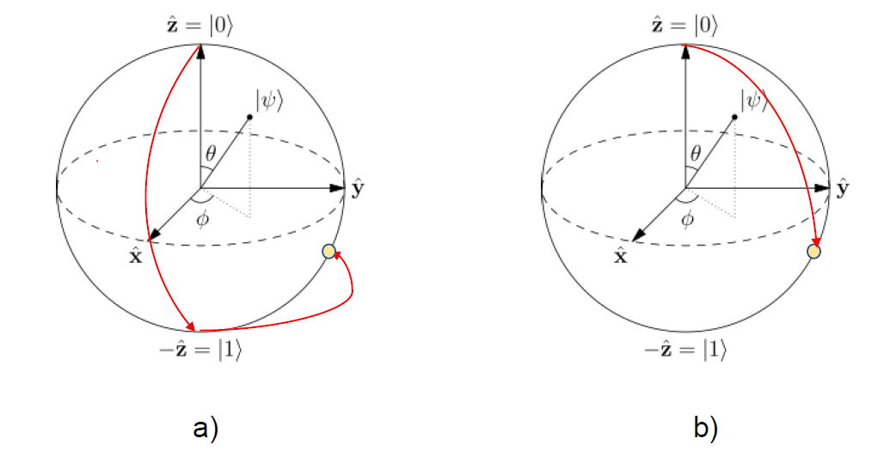
Motivation and Challenges
Gate level optimization generate high redundancy.
Notes:
Quantum Optimal Control (QOC):
Finding an optimal control scheme from a class of allowed control schemes that moves the system from some initial state to a specified target state whose performance is optimal.
Given a unitary matrix, we can use optimal control to find a theoretically best control pulse achieving reduction of pulse latency and increase quantum volumes.

Slide 49
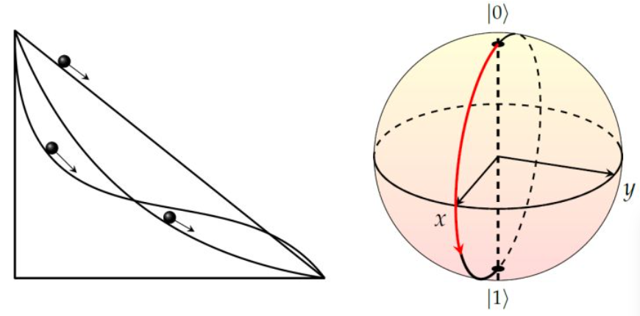
Motivation and Challenges
QOC is limited to few qubits since it is computationally expensive.
Most works demonstrate QOC on quantum simulators, however, it is hard to be evaluated on NISQ machines.
Notes:
Quantum Optimal Control (QOC):
Finding an optimal control scheme from a class of allowed control schemes that moves the system from some initial state to a specified target state whose performance is optimal.
Given a unitary matrix, we can use optimal control to find a theoretically best control pulse achieving reduction of pulse latency and increase quantum volumes.

Slide 50
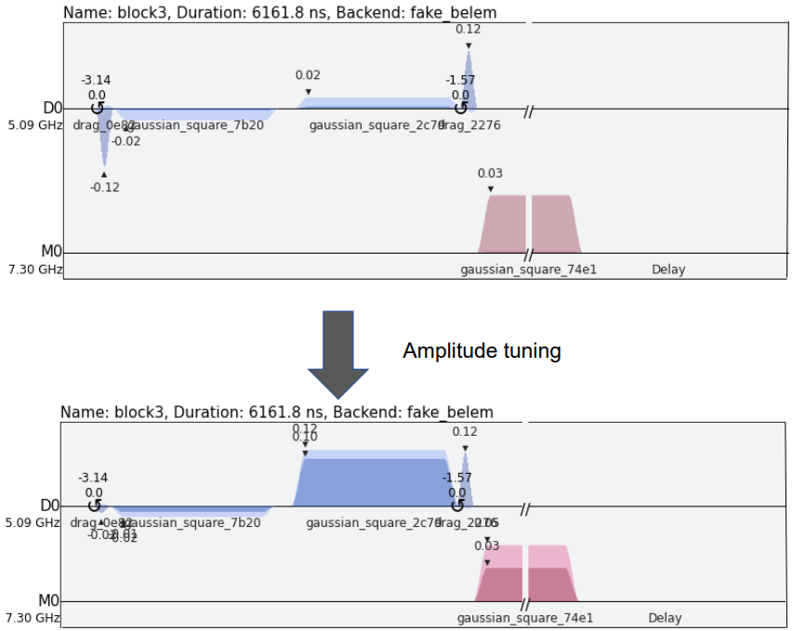

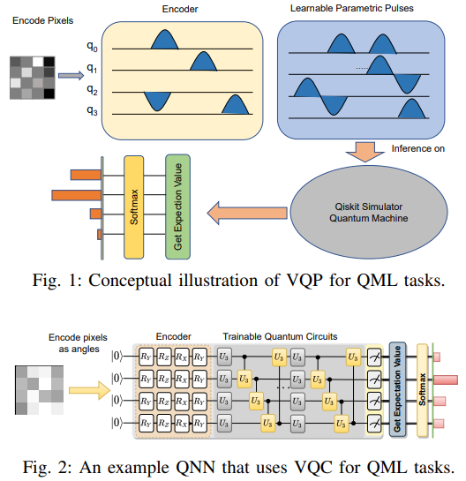


Attempt on Quantum Neural Network
Can we find an intermediate-level approach between the gate level operations and quantum optimal control?
Can we achieve benefits by doing so?

Slide 51
Methodology
1. Enable a Novel Encoder on Pulse-level
2. Intermediate Layer Pulse Learning
3. Noise-Robustness Pulse Learning

Slide 52

Enable a Novel Encoder on Pulse-level
Encode digital numbers to parameters on pulse.
Future perspective: If we can achieve efficient encoding on pulse level?

Slide 53
Methodology
1. Enable a Novel Encoder on Pulse-level
2. Intermediate Layer Pulse Learning
3. Noise-Robustness Pulse Learning

Slide 54
Intermediate Layer Pulse Learning
An intermediate level pulse learning between quantum optimal control and gate optimization scheme with good tradeoff between performance and training cost

Slide 55
Intermediate Layer Pulse Learning
An intermediate level pulse learning between quantum optimal control and gate optimization scheme with good tradeoff between performance and training cost

Slide 56
Intermediate Layer Pulse Learning
An intermediate level pulse learning between quantum optimal control and gate optimization scheme with good tradeoff between performance and training cost
Gate Level Optimization
Intermediate Level Pulse Learning
Pulse Optimal Control
Lowest Training Cost
Low Training Cost
Lowest Latency
Highest Latency
Low Latency
Highest Training Cost

Slide 57
Methodology
1. Enable a Novel Encoder on Pulse-level
2. Intermediate Layer Pulse Learning
3. Noise-Robustness Pulse Learning

Slide 58


Optimization Framework

Slide 59
Pulse based is better than Gate based
Pulse based method has higher accuracy than gate based with same depth/latency.
Model | # of Gates | Accuracy
Gate Based | 9 | 0.62
Pulse Based | 9 | 0.71
Gate Based | 12 | 0.68

Slide 60
Benefits Observed from VQP
Form of CX Gate | Noise Simulator (Quito) | Noise Simulator (Belem) | Noise Simulator (Jakarta)
CRX(pi) gate | 26832.0dt | 32016.0dt | 26832.0dt
CX gate | 25136.0dt | 27728.0dt | 25136.0dt
Advantage in specific gate
Model | # of Gate | Time Duration Ibmq_Jakarta Noise Simulator (Belem)
VQP | 9 | 40816.0dt | 45168.0dt
VQC* | 12 | 58896.0dt | 58768.0dt
VQP_transpiled | 11 | 32368.0dt | 32816.0dt
VQC*_transpiled | 17 | 53008.0dt | 46192.0dt
Advantage in general circuit

Slide 61
Challenge for Pulse Learning
Non-gradient-based optimizer has randomness when parameter in high dimensional space.
Qiskit pulse simulator is not efficient, e.g., need around 3 mins to finish a 9-gate circuit.
Model | # of Gates | Accuracy
Gate Based | 9 | 0.62
Pulse Based | 9 | 0.71
Gate Based | 12 | 0.68
Model | # of Gates | Accuracy
VQP | 9 | 0.71
VQC with gradient | 9 | 0.73
VQC* with gradient | 12 | 0.77
Notes:
This table shows the VQC with gradient-based algorithm and VQP with Bayesian optimization framework, both for same machine learning task.
Gradient based algorithm shows advantages than BO based.
Solution and future task:
Improvement on optimization process.
Developing an efficient and differentiable pulse simulator.

Slide 62

Pulse Ansatz on VQAs
Can we find a hardware efficient ansatz at the pulse level?
What is a good pulse ansatz?

Slide 63



Benefits of Pulse Ansatz
Source of Advantages:
Enable flexible and efficient compilation workflow on pulse-level.

Slide 64




Benefits of Pulse Ansatz
Source of Advantages:
Two-qubit pulse is tunable, whereas two-qubit gates have few flexibility.
❌Nothing can do with two qubits gate
✔ Parameters are tunable on control channel.

Slide 65

Benefits of Pulse Ansatz
Source of Advantages:
Capability to tune frequency on pulse-level
Notes:
The circuit is realized through frequency-tuned pulse sequences.
The probability of getting |00> state for the zero detuning indicates that parametric pulse operations are physically feasible and can be implemented with high fidelity.
The change of final state under different detuning indicates that the variation of pulse parameter indeed physically changes the corresponding quantum operations.
we apply the measurement error mitigation technique which reduces the impact of readout errors.

Slide 66


Framework and Evaluation
Progressive learning fix the problem that non gradient optimizer cannot hold high dimensional parameters, and progressive approaching to target point is also fit the quantum speed limit (QSL) theory.

Slide 67



Framework and Evaluation
97.3% reduction in ansatz duration compared to QuantumNAS.
Reduce duration by 73.6% compared to RealAmplitude Ansatz while maintaining ansatz performance.

Slide 68


Framework and Evaluation
HeH+: average accuracy 99.336%, with 99.895% being the highest achievable accuracy. The absolute difference in energy is 0.003H, close to the requirement of computational chemistry error (0.0016H) with only a toy model.

Slide 69


Framework and Evaluation
Verify the effectiveness of progressive learning scheme.
Notes:
Verify the effectiveness of progressive learning scheme.
The inaccuracy to full configuration interaction (FCI) data continue reducing step by step.
Energy trends shows a better energy be found in step II over step I.

Slide 70
Hands-On Section 2.2 Variational Pulse Learning

Slide 71
TorchQuantum Tutorial Outline
Section 1
Section 2
Section 3
TorchQuantum Basic Usage
Use TorchQuantum on Pulse Level Optimization
Use TorchQuantum on Gate Level Optimization
1.1 Quantum Basics
3.1 QuantumNAS: Ansatz Search and Gate Pruning
2.1 Quantum Optimal Control
1.2 TQ Operations
3.2 QuantumNAT: Noise Injection and Quantization
1.3 TQ Use Examples
2.2 Variational Pulse Learning
3.3 QOC: On-Chip Training
3.4 Transformer for Quantum Circuit Reliability Prediction
1.4 QNN Compression

Slide 72

Challenges of PQC — Noise
Noise degrades PQC reliability
More parameters increase the noise-free accuracy but degrade the measured accuracy
Therefore, circuit architecture is critical
Notes:
However, PQC has two major challenges. Firstly, the quantum noise degrades the PQC reliability. The figures below shows the MNIST-4 image classification accuracy using QNN with different number of parameters.
We find that more parameters can increase the noise-free accuracy in green but may degrade the measured accuracy in yellow. Also, under the same number of parameters, the measured accuracy of different circuit architecture (or called ansatz) varies a lot. Therefore it is critical to design noise-robust circuit architecture.

Slide 73
Challenges of PQC — Large Design Space
Large design space for circuit architecture
Type of gates
⎥0〉
U3
CU3
⎥0〉
X
CZ
⎥0〉
U3
CU3
⎥0〉
X
CZ
⎥0〉
U3
CU3
⎥0〉
X
CZ
⎥0〉
U3
CU3
⎥0〉
X
CZ
Notes:
Another challenge is the large design space of PQC. For example, we can select different types of gates, such as U3 CU3 or X and CZ gates.

Slide 74
Challenges of PQC — Large Design Space
Large design space for circuit architecture
Type of gates
Number of gates
⎥0〉
U3
CU3
⎥0〉
X
CZ
⎥0〉
U3
CU3
⎥0〉
X
CZ
⎥0〉
U3
CU3
⎥0〉
X
CZ
⎥0〉
U3
CU3
⎥0〉
X
CZ
⎥0〉
U3
CU3
⎥0〉
U3
CU3
U3
CU3
⎥0〉
U3
CU3
⎥0〉
U3
CU3
U3
CU3
⎥0〉
U3
CU3
⎥0〉
U3
CU3
U3
CU3
⎥0〉
U3
CU3
⎥0〉
U3
CU3
U3
CU3
Notes:
We can also choose different number of gates.

Slide 75
Challenges of PQC — Large Design Space
Large design space for circuit architecture
Type of gates
Number of gates
Position of gates
⎥0〉
U3
CU3
⎥0〉
X
CZ
⎥0〉
U3
CU3
⎥0〉
X
CZ
⎥0〉
U3
CU3
⎥0〉
X
CZ
⎥0〉
U3
CU3
⎥0〉
X
CZ
⎥0〉
U3
CU3
⎥0〉
U3
CU3
U3
CU3
⎥0〉
U3
CU3
⎥0〉
U3
CU3
U3
CU3
⎥0〉
U3
CU3
⎥0〉
U3
CU3
U3
CU3
⎥0〉
U3
CU3
⎥0〉
U3
CU3
U3
CU3
⎥0〉
U3
CU3
U3
CU3
⎥0〉
⎥0〉
U3
CU3
CU3
U3
U3
⎥0〉
⎥0〉
U3
CU3
CU3
U3
⎥0〉
⎥0〉
U3
CU3
CU3
⎥0〉
Notes:
Even with the same number of gates, the positions of the gates can be very diverse. So the design space is huge.

Slide 76
Goal of QuantumNAS
Automatically & efficiently search for noise-robust quantum circuit
Train one “SuperCircuit”, providing parameters to many “SubCircuits”
(1) Quantum noise feedback in the search loop
(2) Co-search the circuit architecture and qubit mapping
Solve the challenge of large design space
Solve the challenge of large quantum noise
Notes:
The goal of quantumnas is to automatically and efficiency search for noise-robust quantum circuits.
The automatic and efficient search is achieved by the Supercircuit, which is train for once but used for many sub circuit candidates. The noise-robustness is achieved by involving the quantum noise feedback in the search loop and co-searching the circuit architecture and qubit mapping.

Slide 77
QuantumNAS
SuperCircuit Construction and Training
Noise-Adaptive Evolutionary Co-Search of SubCircuit and Qubit Mapping
Train the Searched SubCircuit
Iterative Quantum Gate Pruning
Notes:
Here are the four steps of Quantumnas.

Slide 78
QuantumNAS
SuperCircuit Construction and Training
Noise-Adaptive Evolutionary Co-Search of SubCircuit and Qubit Mapping
Train the Searched SubCircuit
Iterative Quantum Gate Pruning
Notes:
The first is SuperCircuit Construction and Training

Slide 79
SuperCircuit & SubCircuit
Firstly construct a design space. For example, a design space of maximum 4 U3 in the first layer and 4 CU3 gates in the second layer
Notes:
We firstly need to have a pre-defined design space. For example, we can have a design space with 4 U3 gates in the first layer and 4 CU3 gates in the second layer. So the design space contains 2^8 which is 256 candidates. If we train each of them with classical simulator on one Nvidia GPU, that will take around 100 hours which is very costly.

Slide 80
SuperCircuit & SubCircuit
Firstly construct a design space. For example, a design space of maximum 4 U3 in the first layer and 4 CU3 gates in the second layer
SuperCircuit: the circuit with the largest number of gates in the design space
Example: SuperCircuit in U3+CU3 space
⎥0〉
1
8
⎥0〉
2
5
⎥0〉
3
6
⎥0〉
4
7
Notes:
Therefore, we want to enable efficient search with the help of a super circuit. The super circuit is the circuit with the largest number of gates in the design space. Here is the example of the super circuit in U3+CU3 design space which contains 8 gates.

Slide 81
SuperCircuit & SubCircuit
Firstly construct a design space. For example, a design space of maximum 4 U3 in the first layer and 4 CU3 gates in the second layer
SuperCircuit: the circuit with the largest number of gates in the design space
Example: SuperCircuit in U3+CU3 space
Each candidate circuit in the design space (called SubCircuit) is a subset of the SuperCircuit
⎥0〉
1
8
⎥0〉
2
5
⎥0〉
3
6
⎥0〉
4
7
⎥0〉
8
⎥0〉
1
8
⎥0〉
⎥0〉
2
5
⎥0〉
5
2
5
⎥0〉
⎥0〉
3
6
⎥0〉
6
3
⎥0〉
⎥0〉
⎥0〉
7
4
7
⎥0〉
Notes:
SubCircuit is a subset of the super circuit gates. Here we show three examples of sub circuits. The first contains gate…
The second one… the circuit one ..

Slide 82
SuperCircuit Construction
Why use a SuperCircuit?
Enables efficient search of architecture candidates without training each
SubCircuit inherits parameters from SuperCircuit
With inherited parameters, we find some good SubCircuits, we find that they are also good SubCircuits with parameters trained from-scratch individually
Notes:
Since all subcircuits share the parameters of the supercircuit, we need to prevent interference of sub circuit from each other.

Slide 83
SuperCircuit Training
In one SuperCircuit Training step:
Sample a gate subset of SuperCircuit (a SubCircuit)
Front Sampling and Restricted Sampling
Only use the subset to perform the task and updates the parameters in the subset
Parameter updates are cumulative across steps
Notes:
Therefore, we perform super circuit training by iteratively sampling and updating subcircuits.
In one step, we use front sampling the restricted sampling to sample a sub circuit candidate, then use it do the inference and update its parameters.
Parameter updates are cumulative across steps

Slide 84
Train SuperCircuit for Multiple Steps
In one SuperCircuit Training step: Sample and Train
Qubit 0 ⎥0〉
Qubit 1 ⎥0〉
…
Qubit 2 ⎥0〉
Qubit 3 ⎥0〉
Block 1
Block N
Notes:
With the front sampling and restricted sampling, we can perform sub circuit sampling and parameter training for many steps.

Slide 85
Train SuperCircuit for Multiple Steps
In one SuperCircuit Training step: Sample and Train
Qubit 0 ⎥0〉
Qubit 1 ⎥0〉
…
Qubit 2 ⎥0〉
Qubit 3 ⎥0〉
Block 1
Block N
Notes:
With the front sampling and restricted sampling, we can perform sub circuit sampling and parameter training for many steps.

Slide 86
Train SuperCircuit for Multiple Steps
In one SuperCircuit Training step: Sample and Train
Qubit 0 ⎥0〉
Qubit 1 ⎥0〉
…
Qubit 2 ⎥0〉
Qubit 3 ⎥0〉
Block 1
Block N
Notes:
With the front sampling and restricted sampling, we can perform sub circuit sampling and parameter training for many steps.

Slide 87
Train SuperCircuit for Multiple Steps
In one SuperCircuit Training step: Sample and Train
Qubit 0 ⎥0〉
Qubit 1 ⎥0〉
…
Qubit 2 ⎥0〉
Qubit 3 ⎥0〉
Block 1
Block N
Notes:
With the front sampling and restricted sampling, we can perform sub circuit sampling and parameter training for many steps.

Slide 88
Train SuperCircuit for Multiple Steps
In one SuperCircuit Training step: Sample and Train
Qubit 0 ⎥0〉
Qubit 1 ⎥0〉
…
Qubit 2 ⎥0〉
Qubit 3 ⎥0〉
Block 1
Block N
Notes:
With the front sampling and restricted sampling, we can perform sub circuit sampling and parameter training for many steps.

Slide 89
Train SuperCircuit for Multiple Steps
In one SuperCircuit Training step: Sample and Train
Qubit 0 ⎥0〉
Qubit 1 ⎥0〉
…
Qubit 2 ⎥0〉
Qubit 3 ⎥0〉
Block 1
Block N
Notes:
With the front sampling and restricted sampling, we can perform sub circuit sampling and parameter training for many steps.

Slide 90
Train SuperCircuit for Multiple Steps
In one SuperCircuit Training step: Sample and Train
Qubit 0 ⎥0〉
Qubit 1 ⎥0〉
…
Qubit 2 ⎥0〉
Qubit 3 ⎥0〉
Block 1
Block N
Notes:
With the front sampling and restricted sampling, we can perform sub circuit sampling and parameter training for many steps.

Slide 91
Train SuperCircuit for Multiple Steps
In one SuperCircuit Training step: Sample and Train
Qubit 0 ⎥0〉
Qubit 1 ⎥0〉
…
Qubit 2 ⎥0〉
Qubit 3 ⎥0〉
Block 1
Block N
Notes:
With the front sampling and restricted sampling, we can perform sub circuit sampling and parameter training for many steps.

Slide 92
Train SuperCircuit for Multiple Steps
In one SuperCircuit Training step: Sample and Train
Qubit 0 ⎥0〉
Qubit 1 ⎥0〉
…
Qubit 2 ⎥0〉
Qubit 3 ⎥0〉
Block 1
Block N
Notes:
With the front sampling and restricted sampling, we can perform sub circuit sampling and parameter training for many steps.

Slide 93
Train SuperCircuit for Multiple Steps
In one SuperCircuit Training step: Sample and Train
Qubit 0 ⎥0〉
Qubit 1 ⎥0〉
…
Qubit 2 ⎥0〉
Qubit 3 ⎥0〉
Block 1
Block N
Notes:
With the front sampling and restricted sampling, we can perform sub circuit sampling and parameter training for many steps.

Slide 94
Train SuperCircuit for Multiple Steps
In one SuperCircuit Training step: Sample and Train
Qubit 0 ⎥0〉
Qubit 1 ⎥0〉
…
Qubit 2 ⎥0〉
Qubit 3 ⎥0〉
Block 1
Block N
Notes:
With the front sampling and restricted sampling, we can perform sub circuit sampling and parameter training for many steps.

Slide 95
Train SuperCircuit for Multiple Steps
In one SuperCircuit Training step: Sample and Train
Qubit 0 ⎥0〉
Qubit 1 ⎥0〉
…
Qubit 2 ⎥0〉
Qubit 3 ⎥0〉
Block 1
Block N
Notes:
With the front sampling and restricted sampling, we can perform sub circuit sampling and parameter training for many steps.

Slide 96
Train SuperCircuit for Multiple Steps
In one SuperCircuit Training step: Sample and Train
Qubit 0 ⎥0〉
Qubit 1 ⎥0〉
…
Qubit 2 ⎥0〉
Qubit 3 ⎥0〉
Block 1
Block N
Notes:
With the front sampling and restricted sampling, we can perform sub circuit sampling and parameter training for many steps.

Slide 97
Train SuperCircuit for Multiple Steps
In one SuperCircuit Training step: Sample and Train
Qubit 0 ⎥0〉
Qubit 1 ⎥0〉
…
Qubit 2 ⎥0〉
Qubit 3 ⎥0〉
Block 1
Block N
Notes:
With the front sampling and restricted sampling, we can perform sub circuit sampling and parameter training for many steps.

Slide 98
Train SuperCircuit for Multiple Steps
In one SuperCircuit Training step: Sample and Train
Qubit 0 ⎥0〉
Qubit 1 ⎥0〉
…
Qubit 2 ⎥0〉
Qubit 3 ⎥0〉
Block 1
Block N
Notes:
With the front sampling and restricted sampling, we can perform sub circuit sampling and parameter training for many steps.

Slide 99
Train SuperCircuit for Multiple Steps
Qubit 0 ⎥0〉
0.1
Qubit 1 ⎥0〉
0.2
…
Qubit 2 ⎥0〉
0.9
Qubit 3 ⎥0〉
1.1
Block 1
Block N
Qubit 0 ⎥0〉
0.2
Qubit 1 ⎥0〉
-0.1
…
Qubit 2 ⎥0〉
1.4
Qubit 3 ⎥0〉
1.1
Block 1
Block N
Qubit 0 ⎥0〉
0.4
Qubit 1 ⎥0〉
-0.1
…
Qubit 2 ⎥0〉
1.4
Qubit 3 ⎥0〉
1.1
Block 1
Block N
Notes:
With the front sampling and restricted sampling, we can perform sub circuit sampling and parameter training for many steps.

Slide 100
How Reliable is the SuperCircuit?
Inherited parameters from SuperCircuit can provide accurate relative performance
Spearman Corr.:
0.79
Spearman Corr.:
0.91
U3+CU3
MNIST-4
U3+CU3
Fashion-4
Spearman Corr.:
0.76
Spearman Corr.:
0.78
Y-axis: SubCircuit Performance trained from Scratch
ZZ+RY
MNIST-4
ZZ+RY
Fashion-4
X-axis: SubCircuit Performance with Inherted Parameters from SuperCircuit
Notes:
Here we show the reliability of supercircut. The x-axis is SubCircuit Performance with Inherted Parameters from SuperCircuit, y-axis is SubCircuit Performance trained from Scratch. We can see a clear positive correlation between them with a spearman correlation around 0.8. so the inherited parameters are reliable enough to indicate the final performance.

Slide 101
QuantumNAS
SuperCircuit Construction and Training
Noise-Adaptive Evolutionary Co-Search of SubCircuit and Qubit Mapping
Train the Searched SubCircuit
Iterative Quantum Gate Pruning
Notes:
Then we obtain the trained super circuit and enter the next step

Slide 102

Noise-Adaptive Evolutionary Co-Search
Search the best SubCircuit and its qubit mapping on target device
Notes:
We can use the super circuit to perform efficient noise-adaptive search of sub circuit architecture and qubit mapping on target device such as IBMQ Yorktown.

Slide 103
Noise-Adaptive Evolutionary Co-Search
Search the best SubCircuit and its qubit mapping on target device
⎥0〉
⎥0〉
⎥0〉
⎥0〉
⎥0〉
⎥0〉
⎥0〉
⎥0〉
⎥0〉
⎥0〉
⎥0〉
⎥0〉
Evolutionary Search Engine
Mutation Crossover
Parameters from SuperCircuit
Simulate with noise model
Or
Directly run on real QC device
SubCircuit and Qubit Mapping pairs
Notes:
We use the evolution search as the optimization engine. In one iteration, it generates sub circuit architecture and qubit mapping pairs. Those pairs are then evaluated. The parameters are inherited from super circuit with no need for training, then the performance is simulated with noise model or directly run on real QC devices. Here is where the noise information is involved.

Slide 104
Noise-Adaptive Evolutionary Co-Search
Search the best SubCircuit and its qubit mapping on target device
⎥0〉
⎥0〉
⎥0〉
⎥0〉
⎥0〉
⎥0〉
⎥0〉
⎥0〉
⎥0〉
⎥0〉
⎥0〉
⎥0〉
Evolutionary Search Engine
Mutation Crossover
Parameters from SuperCircuit
Simulate with noise model
Or
Directly run on real QC device
SubCircuit and Qubit Mapping pairs
Performance of SubCircuit and Qubit Mapping pairs
Notes:
The performance is then sent back to the evolutionary search engine and the pairs with high performance are selected as parents and new population is generated by mutation and crossover.

Slide 105
QuantumNAS
SuperCircuit Construction and Training
Noise-Adaptive Evolutionary Co-Search of SubCircuit and Qubit Mapping
Train the Searched SubCircuit
Iterative Quantum Gate Pruning
Notes:
After multiple iterations, we can obtain the searched sub circuit architecture and qubit mapping, so we can train the sub circuit from scratch.

Slide 106
QuantumNAS
SuperCircuit Construction and Training
Noise-Adaptive Evolutionary Co-Search of SubCircuit and Qubit Mapping
Train the Searched SubCircuit
Iterative Quantum Gate Pruning
Notes:
Then we can further perform the iterative quantum gate pruning on the trained sub circuit.

Slide 107
Iterative Pruning
Some gates have parameters close to 0
Rotation gate with angle close to 0 has small impact on the results
Iteratively prune small-magnitude gates and fine-tune the remaining parameters
Qubit 0 ⎥0〉
Qubit 1 ⎥0〉
…
Qubit 2 ⎥0〉
Qubit 3 ⎥0〉
Block 1
Block N
Notes:
Specifically, since some gates contain parameters very close to zero, they have small impact to the results. Therefore, we can iteratively prune small-magnitude gates and fine-tune the remaining gate parameters like this.

Slide 108
Iterative Pruning
Some gates have parameters close to 0
Rotation gate with angle close to 0 has small impact on the results
Iteratively prune small-magnitude gates and fine-tune the remaining parameters
Qubit 0 ⎥0〉
Qubit 1 ⎥0〉
0
…
Qubit 2 ⎥0〉
Qubit 3 ⎥0〉
Block 1
Block N
Notes:
Through fine-tuning, the noise-free accuracy can be recovered. Since fewer gates brings less noise, the measured accuracy on real qc devices can be improved.

Slide 109
Iterative Pruning
Some gates have parameters close to 0
Rotation gate with angle close to 0 has small impact on the results
Iteratively prune small-magnitude gates and fine-tune the remaining parameters
Qubit 0 ⎥0〉
Qubit 1 ⎥0〉
0
…
0
Qubit 2 ⎥0〉
Qubit 3 ⎥0〉
Block 1
Block N
Notes:
Through fine-tuning, the noise-free accuracy can be recovered. Since fewer gates brings less noise, the measured accuracy on real qc devices can be improved.

Slide 110
Iterative Pruning
Some gates have parameters close to 0
Rotation gate with angle close to 0 has small impact on the results
Iteratively prune small-magnitude gates and fine-tune the remaining parameters
Qubit 0 ⎥0〉
0
Qubit 1 ⎥0〉
0
…
0
Qubit 2 ⎥0〉
Qubit 3 ⎥0〉
Block 1
Block N
Notes:
Through fine-tuning, the noise-free accuracy can be recovered. Since fewer gates brings less noise, the measured accuracy on real qc devices can be improved.

Slide 111
Iterative Pruning
Some gates have parameters close to 0
Rotation gate with angle close to 0 has small impact on the results
Iteratively prune small-magnitude gates and fine-tune the remaining parameters
Qubit 0 ⎥0〉
0
0
Qubit 1 ⎥0〉
0
…
0
Qubit 2 ⎥0〉
0
Qubit 3 ⎥0〉
Block 1
Block N
Notes:
Through fine-tuning, the noise-free accuracy can be recovered. Since fewer gates brings less noise, the measured accuracy on real qc devices can be improved.

Slide 112
Evaluation Setups: Benchmarks and Devices
Benchmarks
QML classification tasks: MNIST 10-class, 4-class, 2-class, Fashion 4-class, 2-class, Vowel 4-class
VQE task molecules: H2, H2O, LiH, CH4, BeH2
Quantum Devices
IBMQ
#Qubits: 5 to 65
Quantum Volume: 8 to 128
Notes:
For benchmarks, we use classification tasks for QML, including MNIST, fashion mnist and vowel. For VQE, we use five molecules. We run the experiments on IBMQ devices, with 5 to 65 qubits and 8 to 128 quantum volume.

Slide 113
Benchmarks: QNN and VQE
Quantum Neural Networks: classification
Notes:
Quantum neural network benchmarks are used to perform classification tasks. For example, we can use rotation gates to encode classical pixels to quantum states, then trainable quantum layers can be trained from task. The measurement obtains classical outputs from quantum states and the final softmax output classification probability.

Slide 114
Benchmarks: QNN and VQE
Quantum Neural Networks: classification
Variational Quantum Eigensolver: finds the ground state energy of molecule Hamiltonian
Notes:
The variational quantum eigensolver finds the ground state energy of molecule Hamiltonian. The PQC are used to prepare quantum states, and the measurement basis are obtained according to the target molecule.

Slide 115
QML Results
4-classification: MNIST-4 U3+CU3 on IBMQ-Yorktown
QuantumNAS
QuantumNAS delays the accuracy peak, enables more circuit parameters
38%
23%
Number of Parameters
Notes:
Firstly the figure shows the number of parameters vs the measurement accuracy of MNIST4 on ibmq Yorktown machine. The baselines are human design and evolutionary search with no noise information. We can see that QuantumNAS delays the accuracy peak, enables more circuit parameters. Therefore under the same number of parameter, QuantumNAS can bring opt 38% accuracy boost.

Slide 116
Consistent Improvements on Diverse Design Spaces
H2 in different design spaces on IBMQ-Yorktown
QuantumNAS
Measured Expectation Value on IBMQ-Yorktown
Optimal: -1.85
Diverse design spaces
Notes:
For VQE tasks, QuantumNAS can obtain expectation value closer to the optimal number than UCCSD and other baselines.

Slide 117
Scalable to Large #Qubits
On large devices
MNIST-10 accuracy
Method | Noise-Unaware Searched | Random | Human | QuantumNAS
Melbourne (15Q, 8QV, use 15Q) | 11% | 10% | 15% | 32%
Guadalupe (16Q, 32QV, use 16Q) | 14% | 12% | 10% | 15%
Montreal (27Q, 128QV, use 21Q) | 13% | 7% | 14% | 16%
Manhattan (65Q, 32QV, use 21Q) | 11% | 11% | 15% | 18%
More Qubits
Notes:
On the challenging 10 classification tasks, the baseline can only provides less than 15% accuracy which is 5% larger than random guess. while the quantumnas can improves accuracy to 32%.

Slide 118
Effective of Quantum Gate Pruning
For MNIST-4, Quantum gate pruning improves accuracy by 3% on average
MNIST-4 accuracy
Notes:
We also show the individual effect of quantum gate pruning on MNIST-4 task. The pruning can improve the accuracy for divers design spaces by 3% on average.

Slide 119
Time Cost with TorchQuantum
On 1 Nvidia Titan RTX 2080 ti GPU
Step
 | SuperCircuit Training | Noise-Adaptive Co-search | SubCircuit Training | Deployment on Real QC
4 Qubits | 0.5h | 3h | 0.5h | 0.5h
15 Qubits | 5h | 5h | 5h | 1h
21 Qubits | 20h | 10h | 15h | 1h
#qubits
Naive Search
7200
1600x saving
QuantumNAS (Ours)
GPU hours
Notes:
The table here shows the time cost of each step on one Nvidia titan rtf 2080 ti gpu. With the quantumnas method, we can reduce the search cost from over 800 gpu hours to 4.5 hours.
We want to emphasize that the whole pipeline of quantumnas can be performed on real quantum machine. super circuit and sub circuit training can be done with parameter shift.

Slide 120
Hands-On Section 3.1 QuantumNAS

Slide 121
TorchQuantum Tutorial Outline
Section 1
Section 2
Section 3
TorchQuantum Basic Usage
Use TorchQuantum on Pulse Level Optimization
Use TorchQuantum on Gate Level Optimization
1.1 Quantum Basics
3.1 QuantumNAS: Ansatz Search and Gate Pruning
3.1 Quantum Optimal Control
1.2 TQ Operations
3.2 QuantumNAT: Noise Injection and Quantization
1.3 TQ Use Examples
3.2 Variational Pulse Learning
3.3 QOC: On-Chip Training
3.4 Transformer for Quantum Circuit Reliability Prediction
1.4 QNN Compression

Slide 122
QuantumNAS vs. QuantumNAT
QuantumNAS finds noise robust circuit architecture
QuantumNAT finds noise robust circuit parameters

Slide 123

PQC Circuit in QuantumNAT
QNN with multiple nodes
Encoder
Trainable Quantum Layers
Measurements

Slide 124
Three Techniques in QuantumNAT
QuantumNAT:
Normalization: mitigate noise impact
Noise injection: make the parameters aware of noise
Quantization: mitigate noise impact

Slide 125

Post-Measurement Normalization
Normalize the measurement outcome
Along the batch dimension
For example, we train the 4-qubit PQC with batch=50 then we have results as 50 * 4 values

Slide 126

Post-Measurement Normalization
Normalize the measurement outcome
Along the batch dimension
For example, we train the 4-qubit PQC with batch=50 then we have results as 50 * 4 values
Compute the mean and std on of the measurement outcome on each qubit across batch dim

Slide 127
Post-Measurement Normalization
Normalize the measurement outcome
Along the batch dimension
For example, we train the 4-qubit PQC with batch=50 then we have results as 50 * 4 values
Compute the mean and std on of the measurement outcome on each qubit across batch dim
Normalize the measurement outcome with the computed mean and std

Slide 128

Post-Measurement Normalization
Normalize the measurement outcome
Along the batch dimension
Measurement outcome distribution of 50 quantum circuits:
-1
1
-1
1

Slide 129
Post-Measurement Normalization
Normalize the measurement outcome
Along the batch dimension
Measurement outcome distribution of 50 quantum circuits:
-1
1
-1
1

Slide 130

Noise Injection
Inject noise during training on classical simulator
Pauli error
Readout error

Slide 131

Noise Injection
Inject noise during training on classical simulator
Pauli error
Readout error
Pauli error: SX gate: {X: 0.00096, Y: 0.00096, Z: 0.00096, None: 0.99712}
0.984, 0.016
0.022, 0.978
Readout Error Matrix:

Slide 132

Noise Injection
Inject noise during training on classical simulator
Pauli error
Readout error
Pauli error: SX gate: {X: 0.00096, Y: 0.00096, Z: 0.00096, None: 0.99712}
0.984, 0.016
0.022, 0.978
Readout Error Matrix:

Slide 133
Noise Injection
Inject noise during training on classical simulator
Pauli error
Readout error
Pauli error: SX gate: {X: 0.00096, Y: 0.00096, Z: 0.00096, None: 0.99712}
0.984, 0.016
0.022, 0.978
Readout Error Matrix:

Slide 134

Post-Measurement Quantization
Quantize measurement outcomes
Denoising effect
Small errors will be mitigated

Slide 135

Post-Measurement Quantization
Quantize measurement outcomes
Denoising effect
Small errors will be mitigated
Loss term to encourage measurement outcomes to be close to centroids

Slide 136

Post-Measurement Quantization
Quantization reduces errors and improves SNR

Slide 137
Evaluation
Benchmarks
Quantum Machine Learning task:
MNIST 10-class, 4-class, 2-class
Fashion MNIST 10-class, 4-class, 2-class
Vowel 4-class
Cifar-2 class
Quantum Devices
IBMQ
#Qubits: 5 to 15
Quantum Volume: 8 to 32

Slide 138
Consistent Improvements on Various Benchmarks
On IBMQ santiago
Method | MNIST-4 | FMNIST-4 | Vowel-4 | MNIST-2 | FMNIST-2 | Cifar-2
Baseline | 0.30 | 0.32 | 0.28 | 0.84 | 0.78 | 0.51
+ Normalization | 0.41 | 0.61 | 0.29 | 0.87 | 0.68 | 0.56
+Noise Injection | 0.61 | 0.70 | 0.44 | 0.93 | 0.86 | 0.57
+ Quantization | 0.68 | 0.75 | 0.48 | 0.94 | 0.88 | 0.59

Slide 139

Visualization
QuantumNAT stretches the distribution of features
MNIST-2 classification task

Slide 140
Noise Model in TQ
noise_model_tq = tq.NoiseModelTQ(
noise_model_name='ibmq_quito’,
factor=10,
add_thermal=True
)

Slide 141
TorchQuantum Tutorial Outline
Section 1
Section 2
Section 3
TorchQuantum Basic Usage
Use TorchQuantum on Pulse Level Optimization
Use TorchQuantum on Gate Level Optimization
1.1 Quantum Basics
3.1 QuantumNAS: Ansatz Search and Gate Pruning
3.1 Quantum Optimal Control
1.2 TQ Operations
3.2 QuantumNAT: Noise Injection and Quantization
1.3 TQ Use Examples
3.2 Variational Pulse Learning
3.3 QOC: On-Chip Training
3.4 Transformer for Quantum Circuit Reliability Prediction
1.4 QNN Compression

Slide 142

QOC for High Scalability
How to further improve the scalability of PQC training?
Train the parameters directly on real quantum machine

Slide 143

Challenge of On-chip Training: noise
Noise reduces reliability of on-chip computed gradients

Slide 144

Challenge of On-chip Training: noise
Noise reduces reliability of on-chip computed gradients
Small magnitude gradients have large relative errors

Slide 145


Parameter Shift Rules
Calculate the gradient of $θ$ w.r.t. $f\left(θ\right).$

Slide 146
Parameter Shift Rules
Calculate the gradient of $θ$ w.r.t. $f\left(θ\right).$

Slide 147



Parameter Shift Rules
Shift $θ$ twice
$$\frac{∂}{∂θ}f\left(θ\right)=\frac{1}{2}\left(f\left(θ+\frac{π}{2}\right)−f\left(θ−\frac{π}{2}\right)\right)$$

Slide 148

Parameter Shift Rules
This formula is valid to all rotation gates
RZ, RY, RX, RXX, RZZ
One gradient requires two runs on real quantum machine
$$\frac{∂}{∂θ}f\left(θ\right)=\frac{1}{2}\left(f\left(θ+\frac{π}{2}\right)−f\left(θ−\frac{π}{2}\right)\right)$$

Slide 149


Calculate Gradients of PQC
Step 1: Run on QC without shift to obtain $f$

Slide 150


Calculate Gradients of PQC
Step 2: Further forward to get $Loss$

Slide 151


Calculate Gradients of PQC
Step 3: Backpropagation to calculate $\frac{∂Loss}{∂f\left(θ\right)}$

Slide 152

Calculate Gradients of PQC
Step 4: Shift twice and run on QC to calculate $\frac{∂f(θ)}{∂θ_{i}}$

Slide 153

Calculate Gradients of PQC
Step 5: By Chain Rule: $\frac{∂Loss}{∂f\left(θ\right)}\frac{∂f(θ)}{∂θ_{i}}=\frac{∂Loss}{∂θ_{i}}$, sum over 4 passes (4 qubits)
Only forward on quantum device

Slide 154
Probabilistic Gradient Pruning
Small magnitude gradients have large relative errors

Slide 155

Probabilistic Gradient Pruning

Slide 156

Accumulation Window
Keep a record of accumulated gradient magnitude

Slide 157

Accumulation Window
Normalize the accumulated gradient magnitude to a probability distribution

Slide 158

Accumulation Window
Prune the calculation of some gradients according to the probability distribution

Slide 159
Evaluation
Benchmarks
Quantum Machine Learning task: MNIST 4-class, 2-class, Fashion MNIST 4-class, 2-class, Vowel 4-class
Variational Quantum Eigensolver task: H2 molecule
Quantum Devices
IBMQ
#Qubits: 5 to 7
Quantum Volume: 8 to 32
Circuit architecture
RZZ+RY, RXYZ+CZ, RZX+RXX

Slide 160

QNN results
QOC achieved similar results to classical simulation

Slide 161

QNN Training Curves
Classical Train: Train on classical simulator and test on real QC
QC Train: Train and test the model on real QC
QC Train-PGP (QOC): Train and test on real QC with gradient pruning

Slide 162
QNN Training Curves
Gradient pruning can brings 2%~4% accuracy improvements
Pruning accelerates convergence with 2x training time reduction

Slide 163

VQE Training Curves
Gradient pruning can reduce the gap between quantum and classical

Slide 164

Scalability Improvements
On-chip Training is scalable

Slide 165
TorchQuantum Tutorial Outline
Section 1
Section 2
Section 3
TorchQuantum Basic Usage
Use TorchQuantum on Pulse Level Optimization
Use TorchQuantum on Gate Level Optimization
1.1 Quantum Basics
3.1 QuantumNAS: Ansatz Search and Gate Pruning
3.1 Quantum Optimal Control
1.2 TQ Operations
3.2 QuantumNAT: Noise Injection and Quantization
1.3 TQ Use Examples
3.2 Variational Pulse Learning
3.3 QOC: On-Chip Training
3.4 Transformer for Quantum Circuit Reliability Prediction
1.4 QNN Compression

Slide 166

Transformer for Quantum Circuit Reliability Prediction
Use the circuit graph information

Slide 167


Transformer for Quantum Circuit Reliability Prediction
Use PST as the metrics

Slide 168

Dataset collection
Collect dataset on real machine / noisy simulator

Slide 169

Features on each node

Slide 170

Graph Transformer
Graph Transformer

Slide 171

Evaluation
On random generated circuit

Slide 172

Evaluation
Circuits from quantum algorithms

Slide 173
TorchQuantum Tutorial Outline
Section 1
Section 2
Section 3
TorchQuantum Basic Usage
Use TorchQuantum on Pulse Level Optimization
Use TorchQuantum on Gate Level Optimization
1.1 Quantum Basics
3.1 QuantumNAS: Ansatz Search and Gate Pruning
2.1 Quantum Optimal Control
1.2 TQ Operations
3.2 QuantumNAT: Noise Injection and Quantization
1.3 TQ Use Examples
2.2 Variational Pulse Learning
3.3 QOC: On-Chip Training
3.4 Transformer for Quantum Circuit Reliability Prediction
1.4 QNN Compression

Slide 174

Thank you for listening!
https://github.com/mit-han-lab/torchquantum
qmlsys.mit.edu

